Slide 1
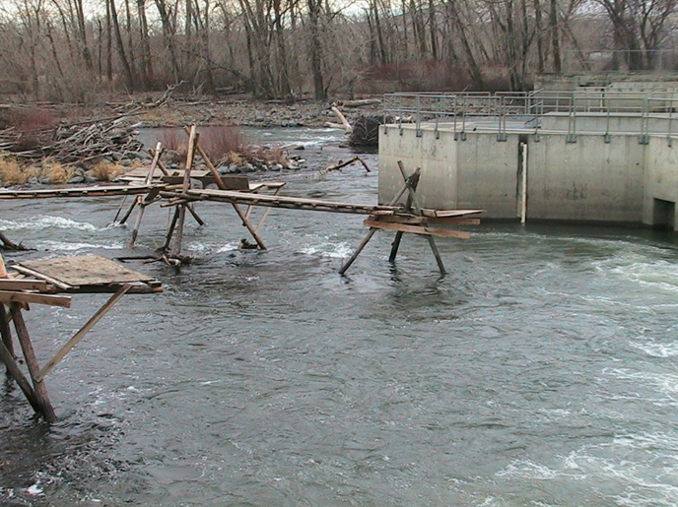
Time Immemorial to 1917 Or How the West Was Won (or lost, depending on which side you were on) A Poor Man’s History of Water by an Undocumented Water Lawyer
Tom Ring
AWRA-Washington State Conference
October 3rd, 2017

Slide 2
The Obligatory Disclaimers
I am not the Yakama Nation, but I work there, in service of the unholy union between the laws of nature and the laws of man
I do not speak for the Tribe, I am staff
No Treaty Rights were killed injured defined, diminished, impaired, or abrogated in the making of this talk.
All opinions expressed herein are my own based on poorly sourced and improperly cited research,

Slide 3
What Was I Thinking?
In Central Washington most irrigated agricultural development and associated impacts occurred before the 1917 adoption of the Water Code.
I pointed this out to the Conference Committee and suggested we recruit a speaker on the subject.
I missed a Conference Committee meeting.
They put me on the agenda.
Here I am … following Charles Wilkinson!!!
What was I thinking??

Slide 4
Outline
Pre Water Code water use
Mostly central Washington
Mostly irrigation
I will leave the legal framework to Tom M.
Effect of water code on early water users
1855ish to 1917
The Earliest Water Users
Time Immemorial to 1855ish

Slide 5
Before The Water Code All Was Formless and Void
Third Biennial Report of the Department of Conservation and Development, 1927

Slide 6
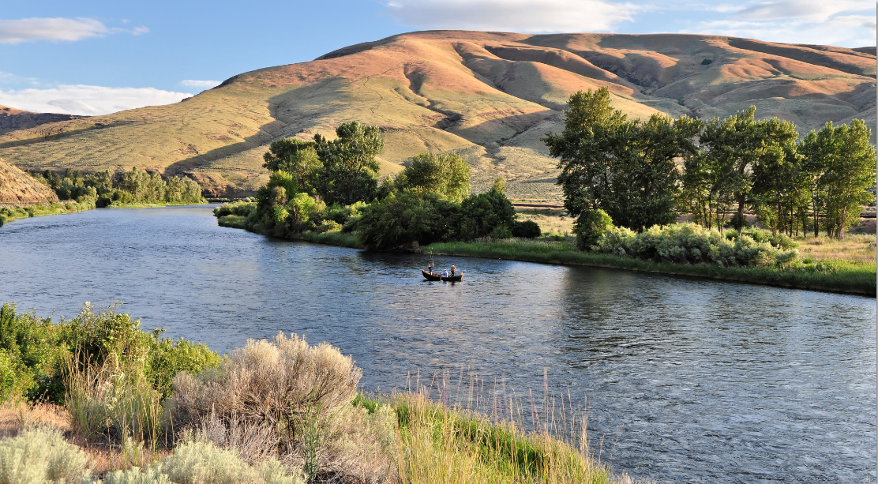
An Alternative (eye witness) View (1861)
"At that time, the bottom lands were covered with a dense growth of rye grass twelve feet high in many places, while a luxuriant carpet of nutritious bunch grass made the sage brush hills a veritable paradise to cattle and horses. Within five minutes after turning loose the animals, they would be completely lost sight of in the tall grass and could be found only by trailing… Indeed, (the Indians) rendered us valuable service during the late fall of 1861, by bringing great quantities of salmon, which could be procured from them at trifling cost. A string of beads, costing ten cents, would purchase a thirty-pound fish."
Leonard Thorp, son of F. Mortimer Thorp (1822-1894)
http://www.historylink.org/File/9187
Tom Ring Photo

Slide 7
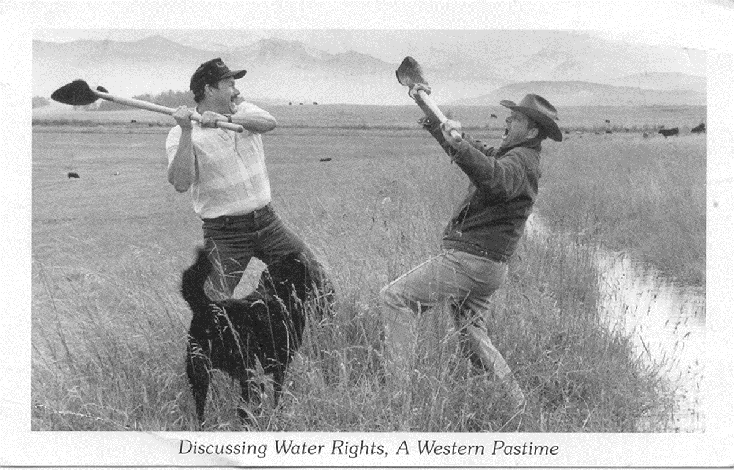
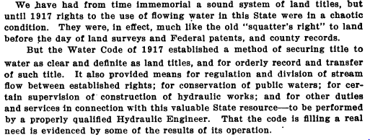
From Time Immemorial to 1917: “Chaotic”
Third Biennial Report of the Department of Conservation and Development, 1927

Slide 8
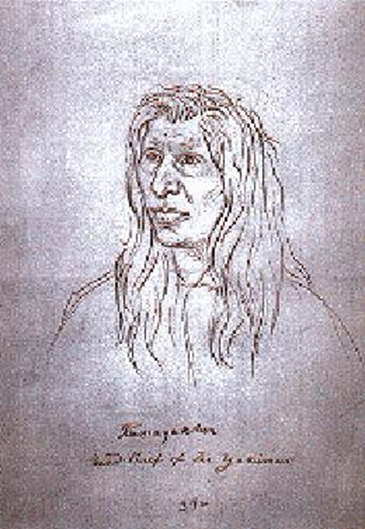
The End of the Beginning and Beginning of the End
The Washington Historical Quarterly
Vol 9 No 3 (July 1918)
http://journals.lib.washington.edu/index.php/WHQ/issue/view/458
Kamiakin, chief of Yakama Tribe, 1855 Sketch by Gustavus Sohon, Courtesy Washington State Historical Society
http://www.historylink.org/File/10096

Slide 9
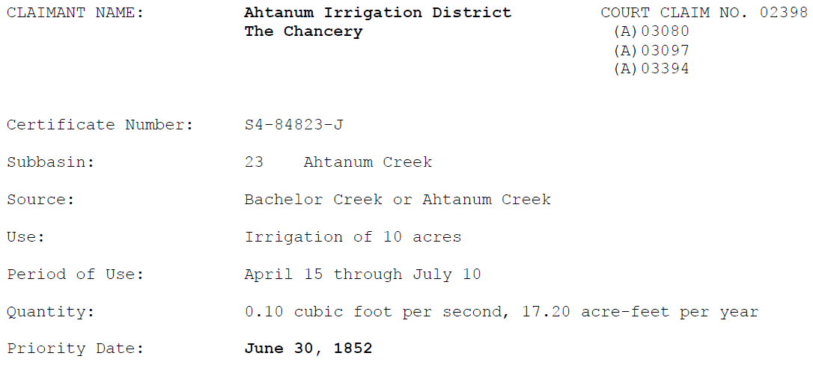
Draft schedule of rights by subbasin and Yakima river adjudication conditional final orders Last updated: August 25, 2017

Slide 10
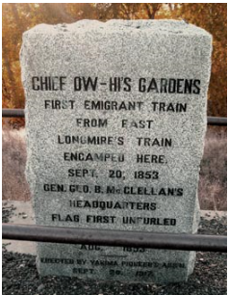
Upper Yakamas in the Wenas Valley, led by Owhi, host Longmire-Byles wagon train headed for Naches Pass on September 20, 1853
Yakama chief Owhi hosted the settlers passing through to Puget Sound in thriving crop fields that the Yakamas have planted in the well-watered valley bottom using irrigation techniques recently learned from Oblate priests at their mission on Ahtanum Creek farther down the Yakima Valley.
According to anthropologist Helen H. Schuster, the Yakama got vegetable seeds from Hudson's Bay Company farms at Fort Vancouver and Fort Nisqually.
The new agricultural practices and crops on Wenas Creek were added to the Upper Yakamas' traditional seasonal movement through the local valleys and mountains, where they maintained and utilized berry fields, camas beds, and numerous other native plants that supplied food, animal forage, and materials for making many articles of daily life, in addition to fishing, hunting, and (since acquiring horses in the 1730s) raising large horse herds.
When the first westbound settlers arrived by wagon train in the Wenas Valley in September 1853, they found Owhi's band taking advantage of the native grasses and farming land irrigated with water from Wenas Creek.
The Upper Yakamas were removed from the Wenas Valley and it was opened to homesteading in 1858. (The Road to Hell is Paved With Good Intentions-Ring’s rule number 1)
http://www.historylink.org/File/10719

Slide 11
"And no Indian can remain a chief here in this land if he does not make his peace with me."
Colonel George Wright, April 1856
https://www.aaanativearts.com/yakama-chiefs/yakama-chief-kamiakin-ca-1800-1877

Slide 12
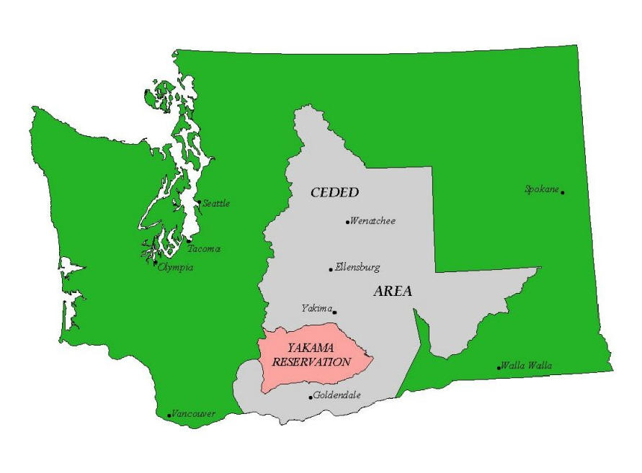
Yakama Country YN rights on this landscape were reserved in perpetuity by (a Stevens) Treaty
Our people who signed the Treaty were not educated, but they knew what was important to them.
They knew what they needed to live.
Yakama Tribal Council Member
Treaty of 1855 Reserved Fishing and other rights on 10 Million Acres With Treaty Instream Flow, hunting, fishing, etc. Rights (Winans, Quackenbush, Acquavella et al)
Treaty of 1855 Reserved 1.4 Million Acre Reservation With Treaty Irrigation (and other) Rights (Winters)

Slide 13
So, What Did They Need To Survive? First, the Water
The people were profoundly grateful. They had been taught since time immemorial by “great prophets” of “laws that had been established” to know of the Creator‘s existence: “first, the water; second, the salmon; third, the big game; fourth, the roots; and fifth, the berries.”
FINDING CHIEF KAMIAKIN
The Life and Legacy of a Northwest Patriot
Text by Richard D. Scheuerman and Michael O. Finley
Introduction by Albert Redstar Andrews
https://rdscheuerman.files.wordpress.com/2009/11/finding-chief-kamiakin-2008.pdf

Slide 14
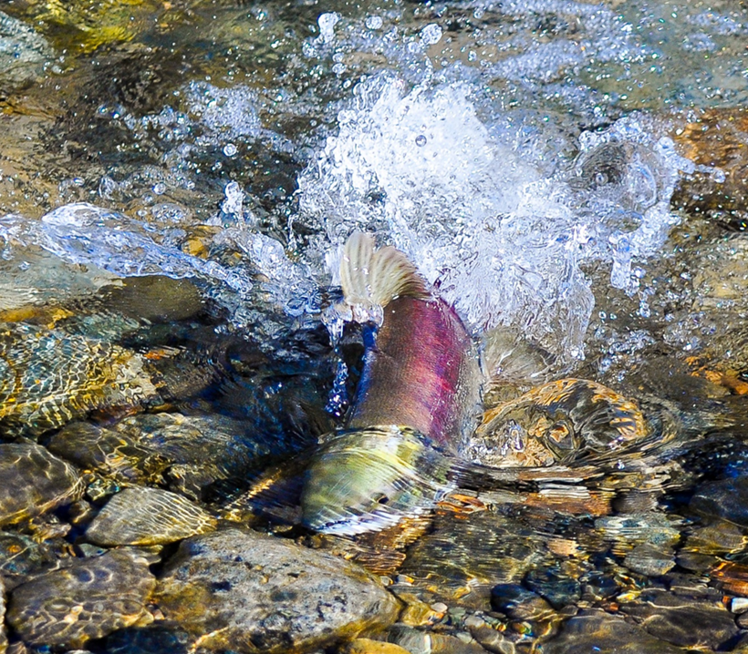
The Unquantified Sea
When the United States created the State of Washington, they didn’t give us all the water. They held some back to meet pre-existing commitments. Everything we do as a State is floating on top of this unquantified sea of federal obligations.
State Sen. Karen Fraser
Protection of Treaty rights is a solemn obligation of federal gov. and “no principle of federalism requires the federal government to defer to the states in their protection”.
Admission to Union had no effect on treaty rights, but imposed obligation to “observe and carry out the provisions” of the treaties.
Tom Ring photo
Sockeye reintroduced to Cle Elum River by Yakama Nation

Slide 15
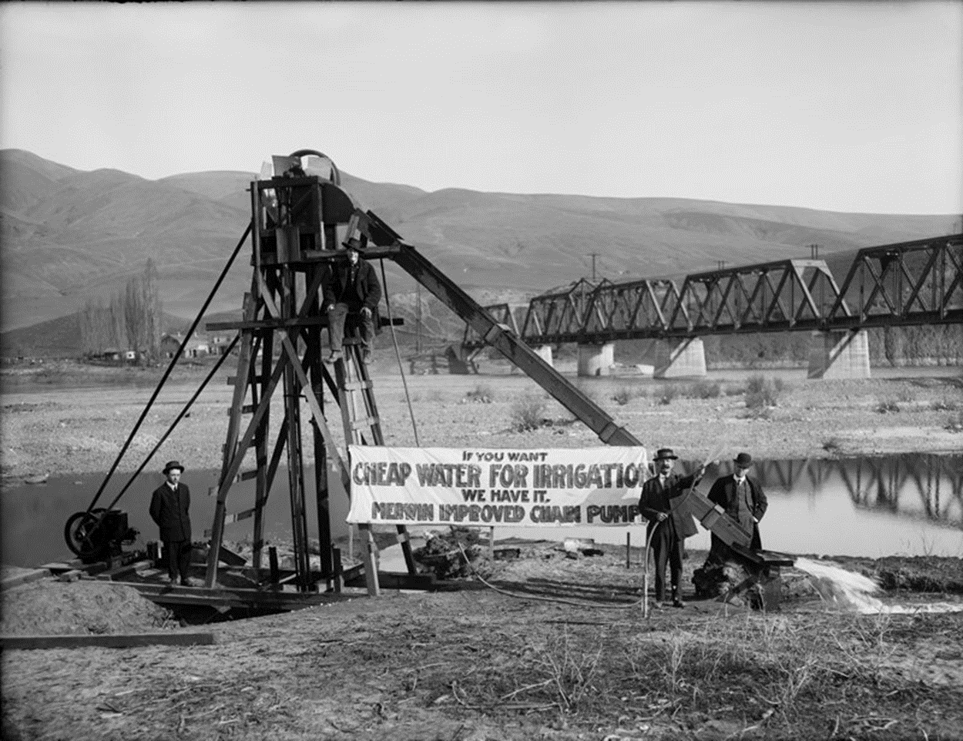
After the Treaty: Cheap Water Meets Cheap Land
https://www.nwcouncil.org/history/Irrigation
These irrigation promoters invited farmers to view their rig on the banks of the Snake River around 1900. Copyright: Historic Photo Archives, Portland, Oregon.
Application of James M. Perry to purchase land in Four Lakes, Spokane County, Washington Territory.... contract no. 23036, issued by the Northern Pacific Railroad Co. Western Land Dept., dated July 28, 1880. Title assigned by cataloger
http://www.washingtonhistory.org/collections/item.aspx?irn=51090&record=5

Slide 16
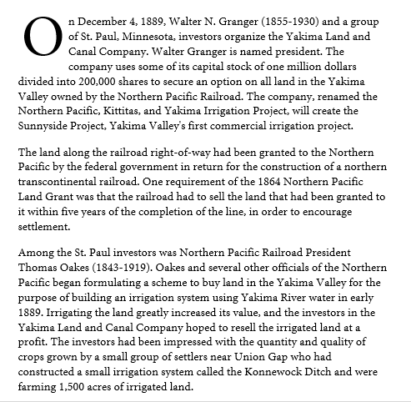
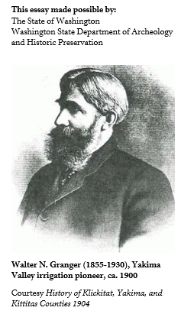
The Northern Pacific was able to sell irrigated land for as much as $40 to $50 per acre as compared with $2.60 per acre for dry land, a powerful inducement for the railroad to fund irrigation. http://www.historylink.org/File/7651

Slide 17
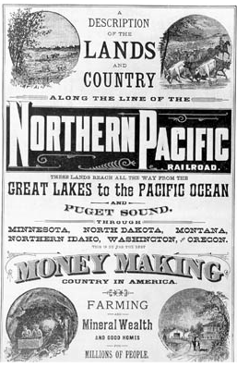
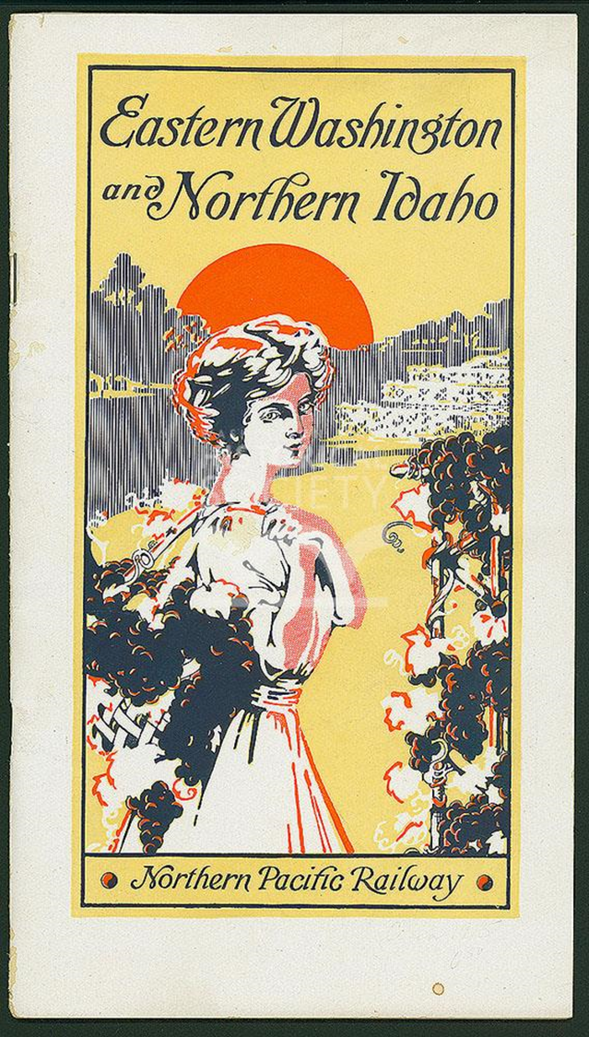
“THIS IS BY FAR THE BEST MONEY MAKING COUNTRY IN AMERICA”
Eastern Washington and Northern Idaho: being a description of the conditions and opportunities as they exist for the homeseeker and investor in this land of fortune
1915 Prospectus
http://www.washingtonhistory.org/collections/item.aspx?irn=10255&record=227
http://www.historylink.org/Content/Media/Photos/Small/req126.JPG

Slide 18
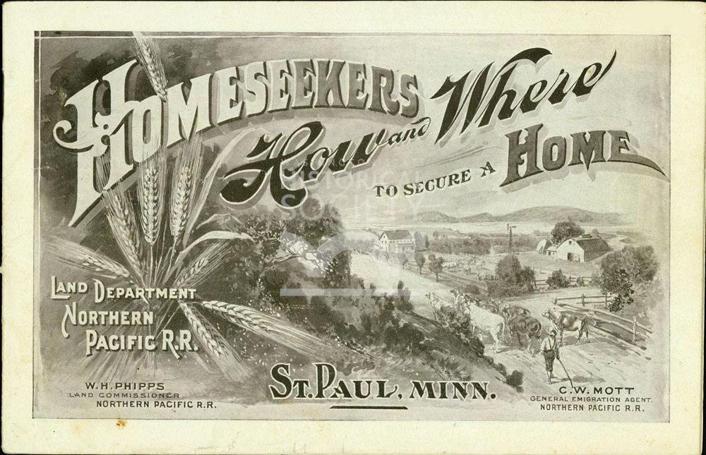
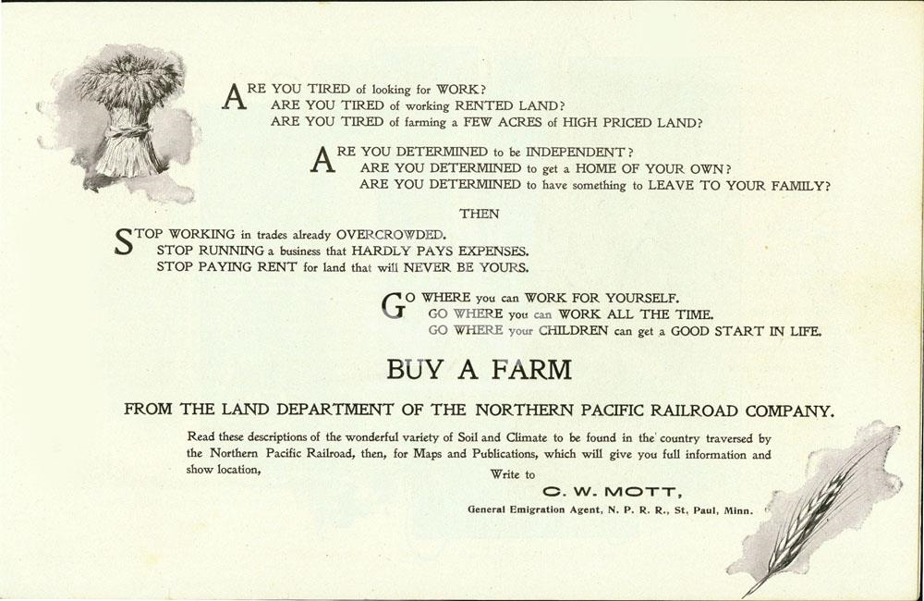
Go where you can work all the time ????
promotional pamphlet, "Homeseekers, how and where to secure a home," 30 pages, illustrated, published by the Northern Pacific Railroad Company, Land Department, St. Paul, Minnesota, C. W. Mott, General Emigration Agent, 1896; Eastern, central and western Washington described pp. 23-29; Includes land prices and description.
http://www.washingtonhistory.org/collections/item.aspx?irn=54882&record=2

Slide 19
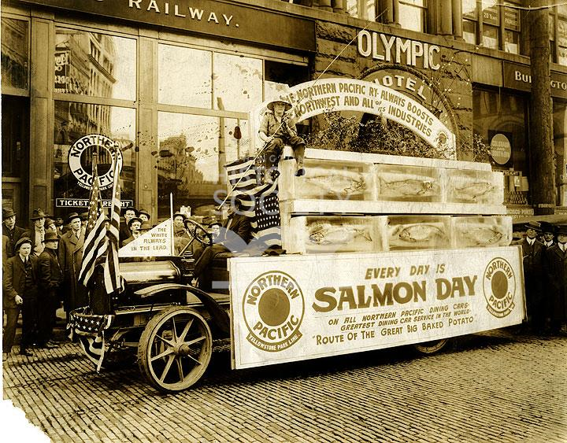
Every Day is Salmon Day
Black and white photographic image of a Northern Pacific Railway Salmon Day parade float mounted on a flatbed truck, parked in front of the Olympic Hotel, Seattle, King County, WA, Mar. 1915. Six boxes with open sides displaying whole salmons are stacked on the visible side of the truck. A boy holding a fishing pole sits on top of the boxes. Signs on the truck: Every Day is Salmon Day, on all Northern Pacific Dining Cars, Greatest Dining Car Service in the World, Route of the Great Big Baked Potato; http://www.washingtonhistory.org/collections/item.aspx?irn=123694&record=126

Slide 20
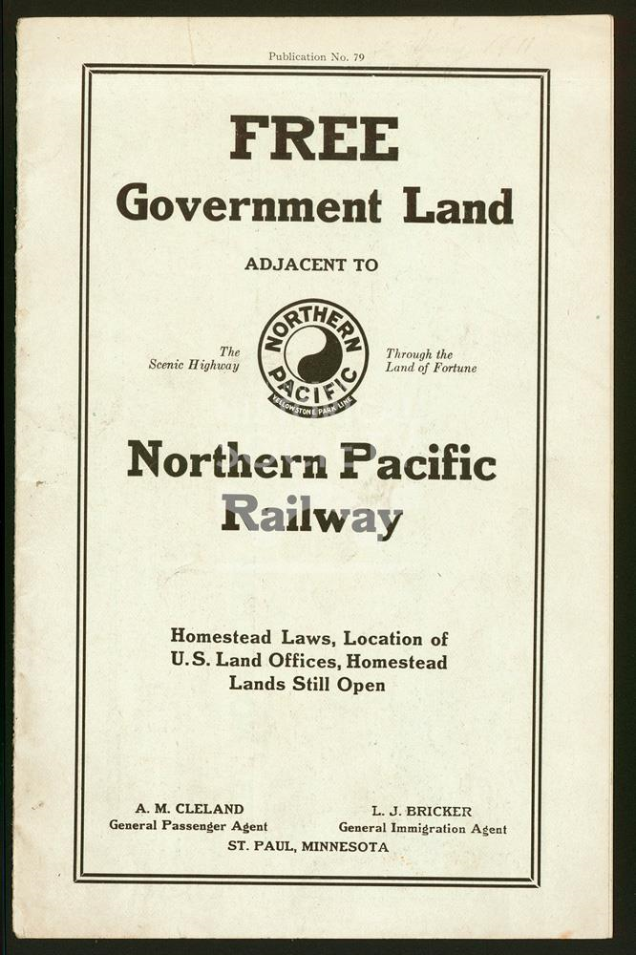
The Scenic Highway Through the Land of Fortune
Promotional pamphlet describing Homestead Laws, Location of U.S. Land Offices, and homestead lands still open, published by the Northern Pacific Railway, to encourage emigration and land settlement, 1911. 15 p.; map.
http://www.washingtonhistory.org/collections/item.aspx?irn=65202&record=252

Slide 21
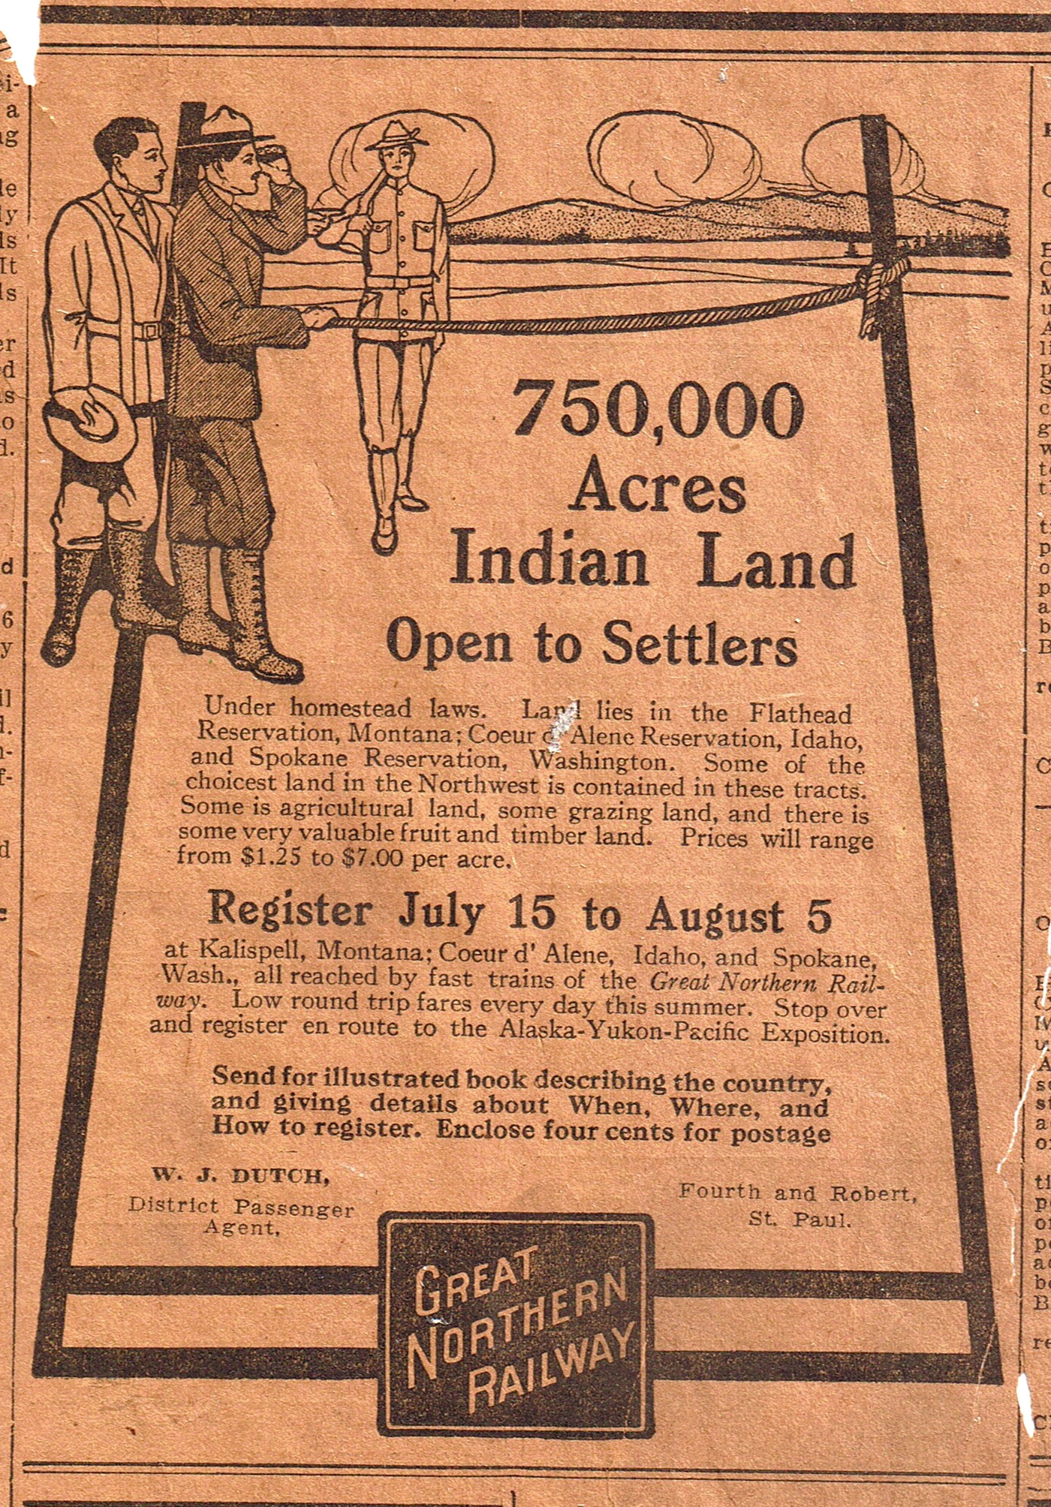
Ya’ll Come
The Great Northern energetically promoted settlement along its lines in North Dakota and Montana, especially by German and Scandinavians from Europe. The Great Northern bought its lands from the federal government – it received no land grants - and resold them to farmers one by one. It operated agencies in Germany and Scandinavia that promoted its lands, and brought families over at low cost, building special colonist cars to transport immigrant families.
https://upload.wikimedia.org/wikipedia/commons/4/4e/Greatnorthernad.jpg

Slide 22
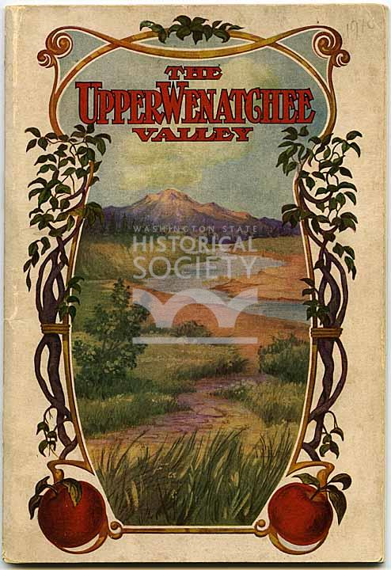
Of Course, not just the Yakima Other east slope tribs saw much irrigation development, but less due to geography.
" Upper Wenatchee Valley, The farther up the valley you go, the bigger and redder the apples grow," published by the Leavenworth Echo, 62 pages, dated 1907;
http://www.washingtonhistory.org/collections/item.aspx?irn=61311&record=1

Slide 23
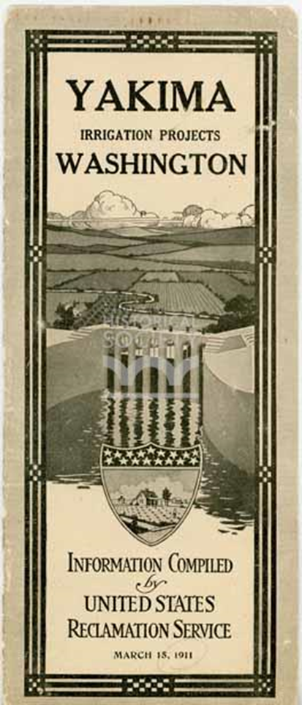
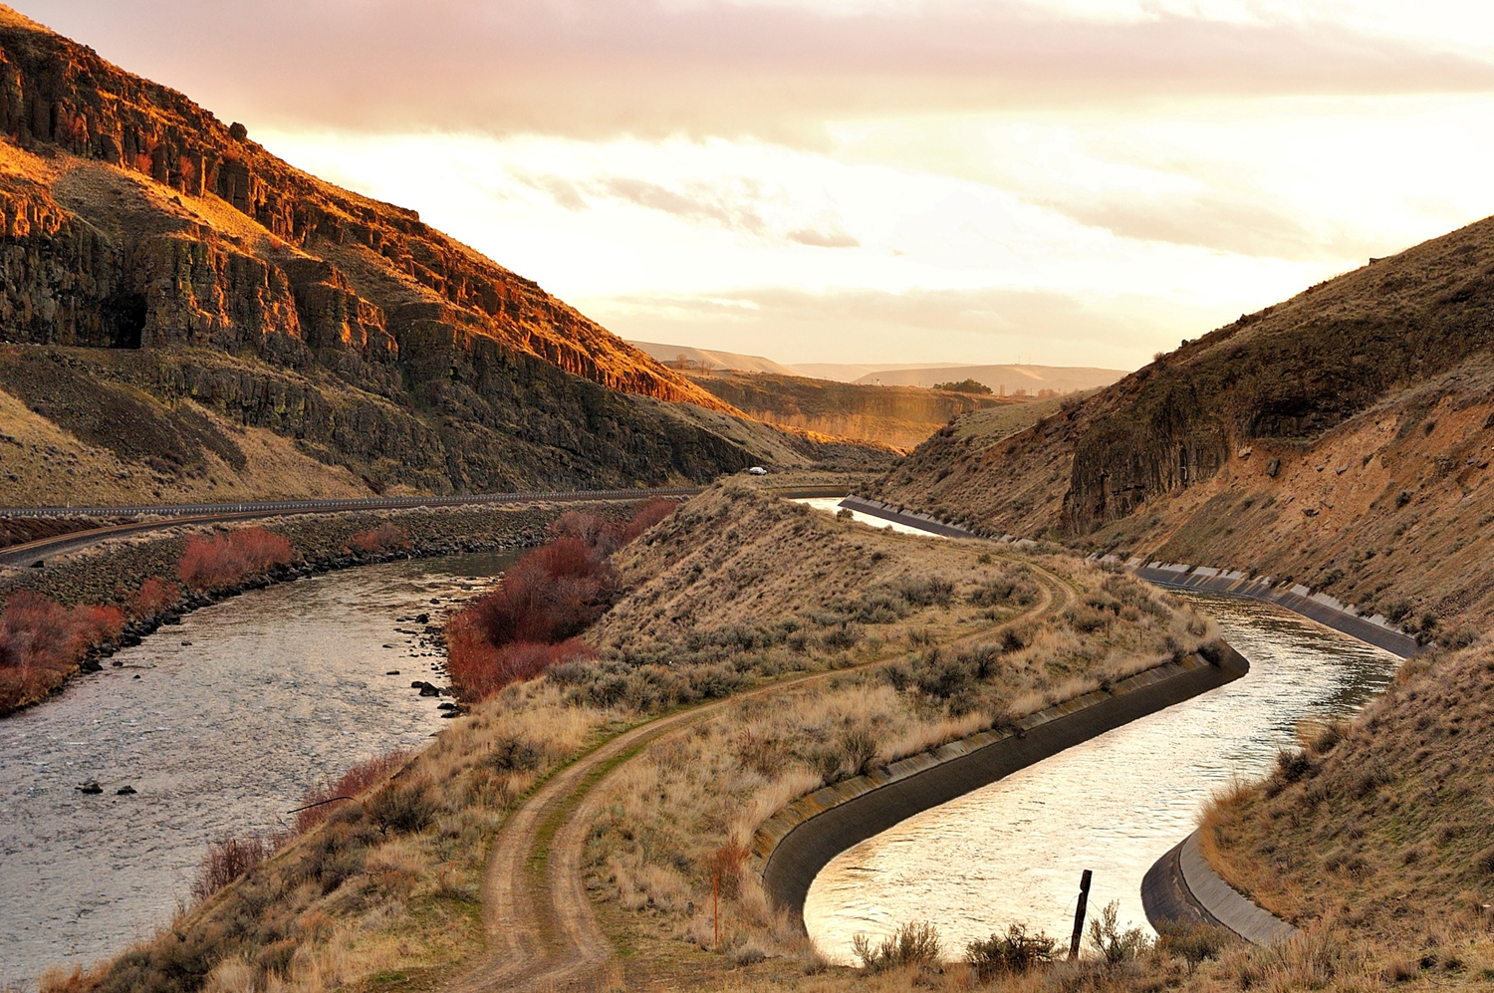
1905 - The Feds Take Over Reclamation fully appropriates Yakima basin for second time, leaving little for the Water Code to do
This time the basin was fully appropriated by engineering design
Reservoirs were built to store most runoff and new canals built to irrigate new lands.
Pre-1905 users entered into limiting agreements.
May 10th, 1905 Reclamation withdrew from appropriation all unappropriated surface waters in the Yakima basin.
The relationships among pre-1905 and 1905 users were defined not by adjudication under the Water Code, but in a federal court case (Kittitas Reclamation District vs Sunnyside Valley Irrigation District) in 1945.
http://www.washingtonhistory.org/collections/item.aspx?irn=107652&record=10

Slide 24
A Railroad Job
HISTORY
The Washington Irrigation Company and its predecessor owners first served lands currently within the boundaries of the Sunnyside Valley Irrigation District (SVID). In 1892 the first water was delivered by the Northern Pacific and Yakima Irrigation Company, a subsidiary of the Northern Pacific Railroad.
On October 23, 1905, the United States Reclamation Service, now the Bureau of Reclamation, purchased the Sunnyside Canal system from the Washington Irrigation Company. The Sunnyside Waterusers’ Association was formed in 1906 to provide an entity to contract with the United States Reclamation Service.
The Sunnyside Valley Irrigation District (SVID) was organized on January 22, 1917, to replace the Sunnyside Water Users Association.
http://www.svid.org/images/Fact%20Sheets%20SVID.pdf

Slide 25
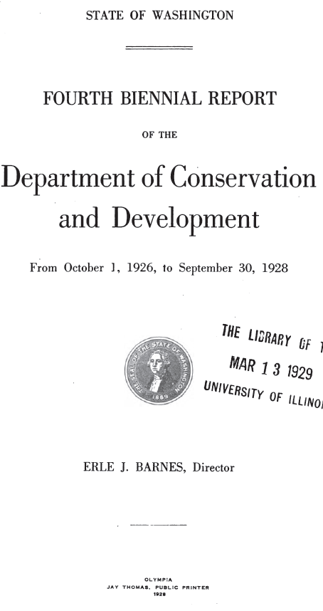
Just When You Thought It Was Safe To Go Back In The Water Code
In Central Washington, the main post Water Code activity was not issuing new water rights, but quantifying and grandfathering in pre- Water Code ones, mostly irrigation diversions.
Fourth Biennial Report of the Department of Conservation and Development, 1928

Slide 26
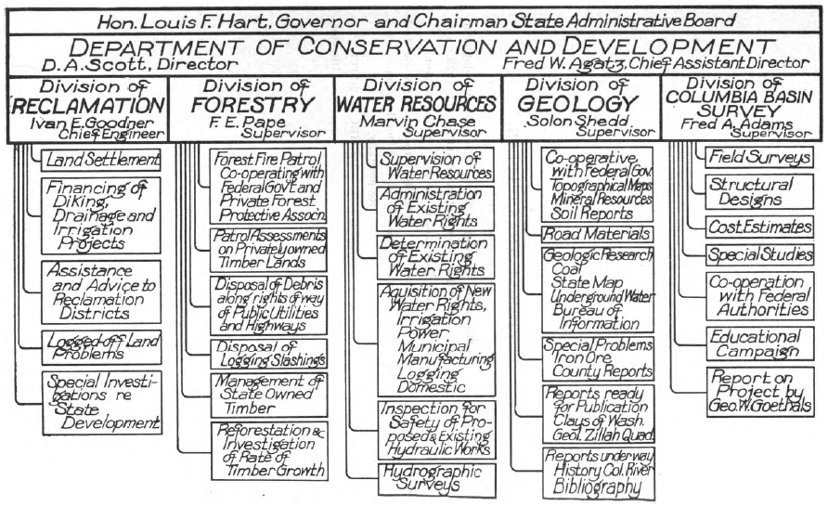
How the Dept of Conservation and Development Saw its job in 1922
Administration of existing rights
Determination of existing rights
Aquisition (sic) of new rights
* Protecting instream values would have to wait 50 years
First Report of the Department of Conservation and Development, From April 1, 1921 to September 30, 1922

Slide 27
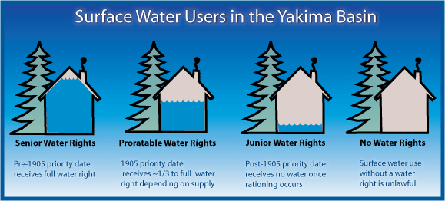
Surface Water Rights in the Yakima River Basin
No Groundwater in The Adjudication
No WAC flows

Slide 28
Post Water Code Rights are Juniorest
All post May 10th surface water rights in the Yakima basin are curtailed whenever prorationing is occurring.
In 2015, all Teanaway River surface water rights younger than 1883 were curtailed.
The petition that closed upper Kittitas County to new unmitigated exempt wells was premised on protecting May 10th, 1905 water rights.
All water rights used for exempt well mitigation in Kittitas County are pre-May 10th, 1905.

Slide 29
Pre-Water Code Work in 2017
Much of Ecology’s modern work in the Yakima basin involves regulating, protecting, and transferring pre-Water Code rights.
(rearranging the deck chairs on the Titanic?)

Slide 30
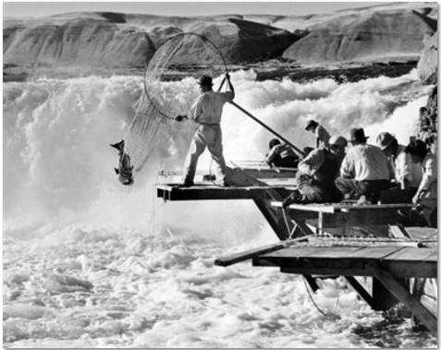
Subject to Existing Rights So how about those Treaty Water Rights?

Slide 31
Before Time Immemorial Alpine and Continental Glaciation
Notes:
Our people have been here since the ice age.
Yakama records--- the linguistic complexity of the many dialects, the oral history, and legends pre-date the Missoula floods.
• The Missoula Floods filled the Palouse and Yakima area with millions of gallons of water, carrying rocks, silt, and depositing
into the Yakima Valley.
• This created many layers of silt and rocks across the valley and pushed Yakima River over to the west approximately 20 miles
away from its current course.

Slide 32
How to Create Habitat for Sockeye: Have an ice age
Before the Deluge
After adult Sockeye Salmon spawn in a stream, juvenile sockeye spend the first year of their lives in lakes before outmigrating.
Alpine glaciation created sockeye lakes in the Yakima basin, four of which were converted into storage reservoirs.
This geologic history left a bounty of aquatic and terrestrial resources
This bounty proved sustainable to people for many hundreds of generations

Slide 33
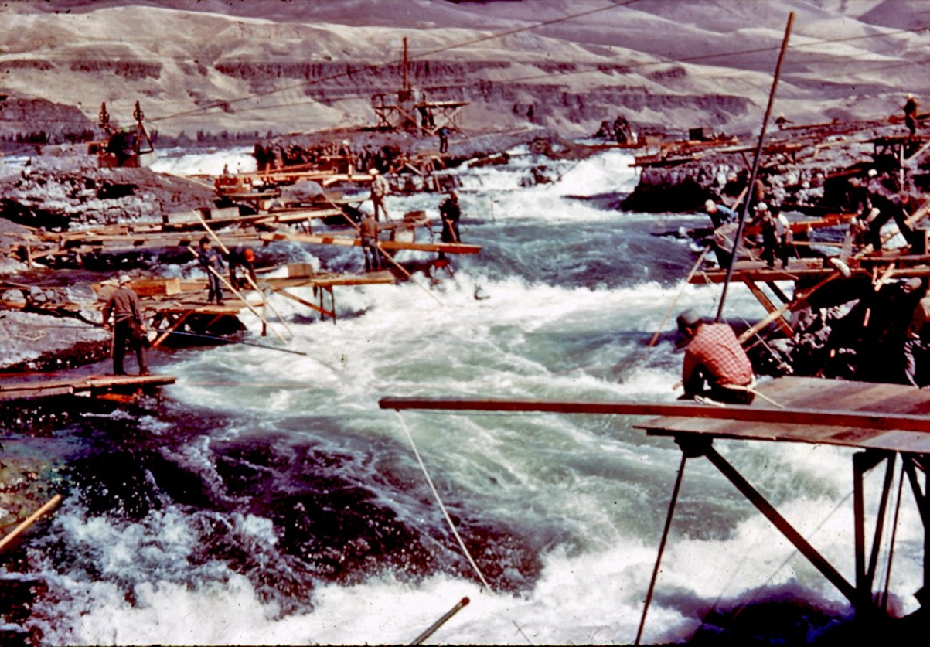
Celilo Falls:
Hub of The First Great Economy of The Pacific Northwest
“This is the Great Mart of all this Country”
Journals of Lewis and Clark
Lewis and Clark … estimated that in 1805 and 1806, between 7,400 and 10,400 Indians were living permanently or seasonally encamped between the Cascade Rapids (near today's Bonneville Dam) and The Dalles.
http://www.historylink.org/index.cfm?DisplayPage=output.cfm&file_id=10010
… ancient fisheries with the uncounted thousands of years of cultural traditions that accompanied fishing and ancillary activities. These activities included inter-Tribal trade of which the bounty and resources of the Great Plains, the Great Basin, Plateau and Coastal cultures were brought to The Dalles.
http://www.ccrh.org/comm/camas/primary%20docs/report.htm (sorry, but this excellent website went away)
Photo from critfc.org

Slide 34
The Atmosphere they Breathed
The right to resort to the fishing places in controversy was a part of larger rights possessed by the Indians, upon the exercise of which there was not a shadow of impediment, and which were not much less necessary to the existence of the Indians than the atmosphere they breathed.
Justice Joseph Mckenna
U.S. Supreme Court5

Slide 35
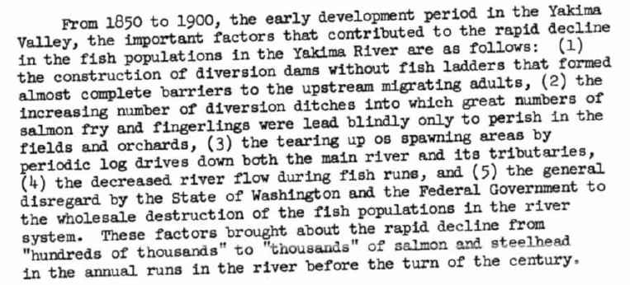
Post Treaty, Pre Reclamation Fish Declines Hundreds of thousands to thousands
Joe Meninick, Yakama Tribal Council, 1968 Hearing on Bumping Lake Enlargement

Slide 36
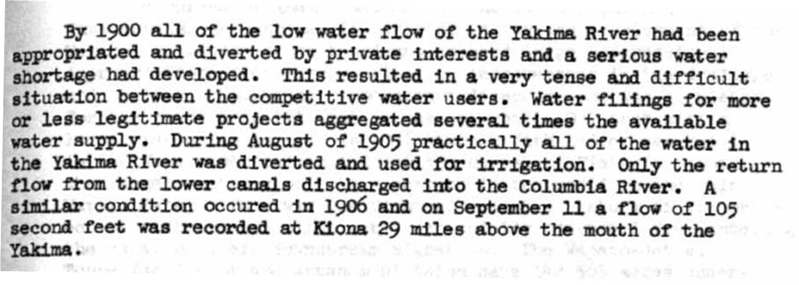
“By 1900 all of the low water flow of the Yakima River had been appropriated and diverted”
Sunnyside Dam in 1905
⬅Yakima River
Sunnyside Canal ➔
Joe Meninick, Yakama Tribal Council, 1968 Hearing on Bumping Lake Enlargement

Slide 37
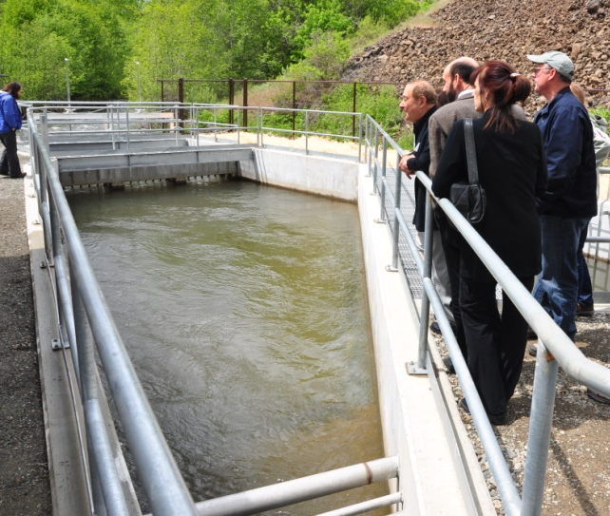
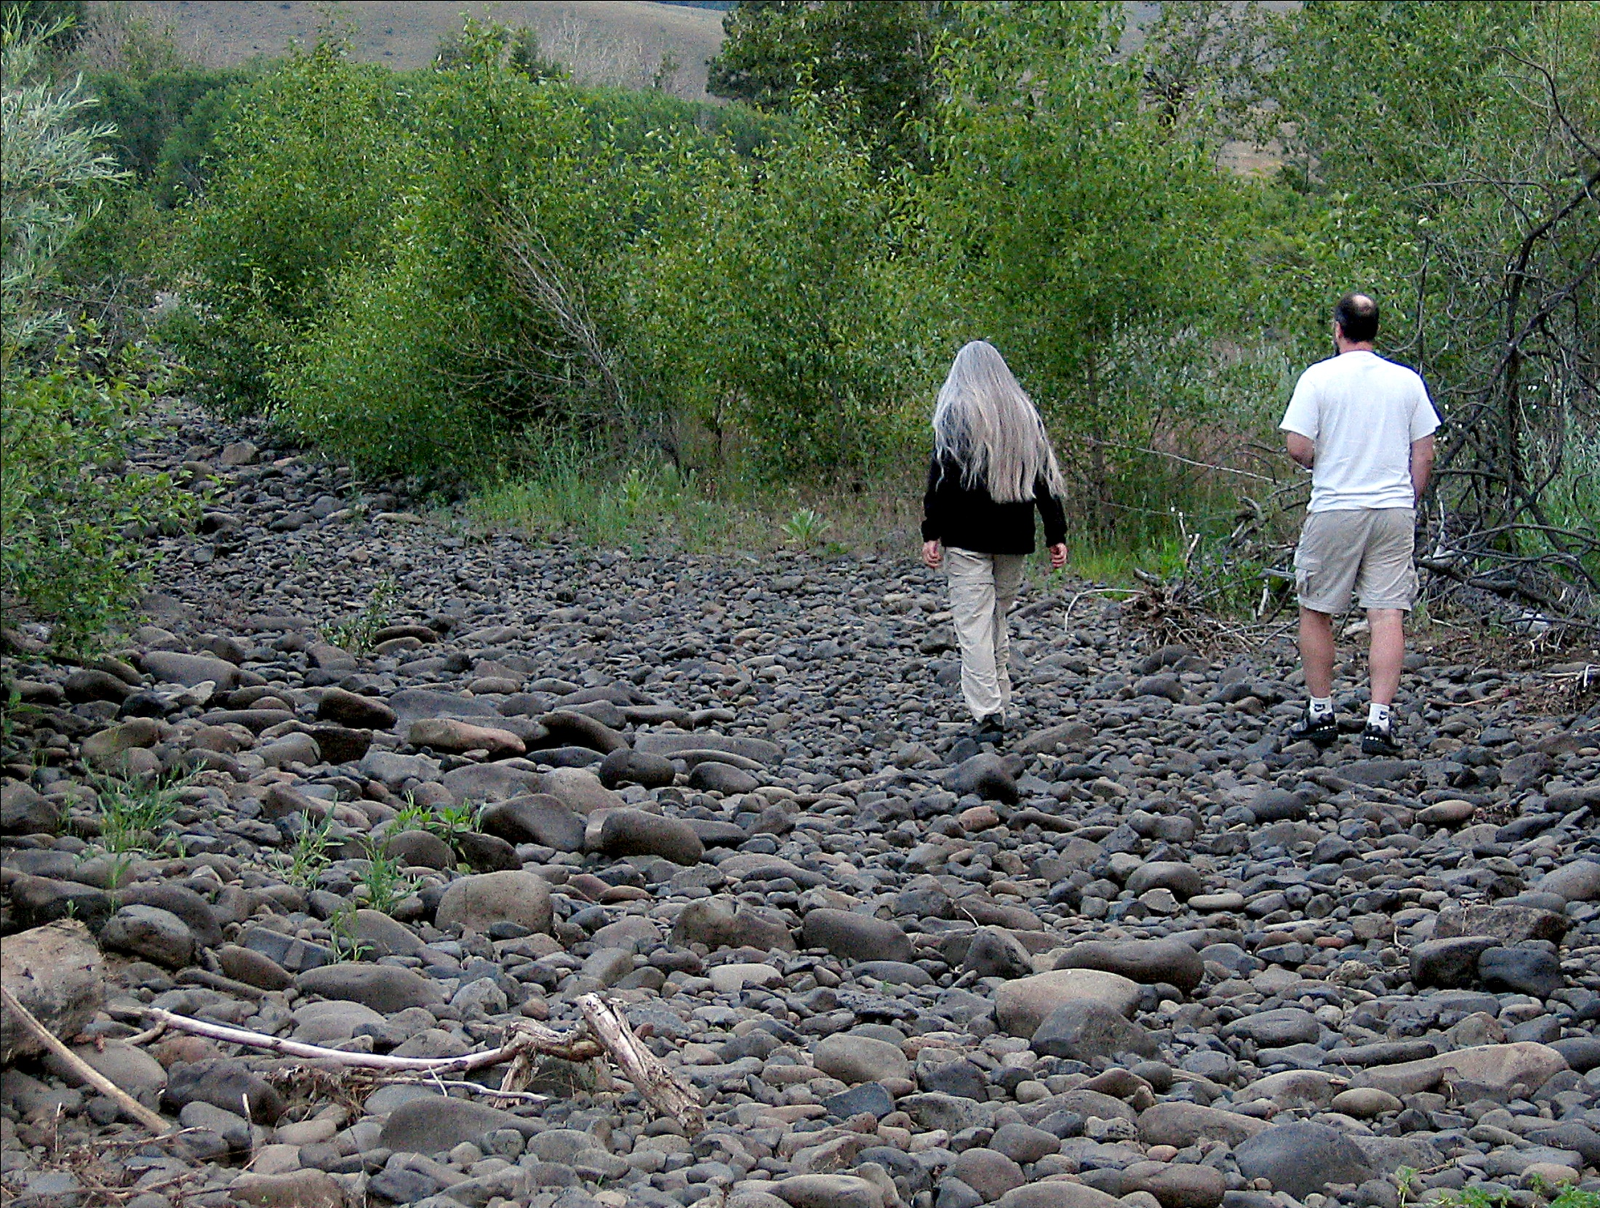
Fixed!
Manastash Creek
(Below the diversions)
We can share what we got of yours, cuz we done shared all of mine. Grateful Dead - 1972

Slide 38
Changing hydrograph
Effects of storage and diversion
Inverted, truncated
Upper basin
Southern
hemisphere
Tieton
Depressed
Lower basin

Slide 39
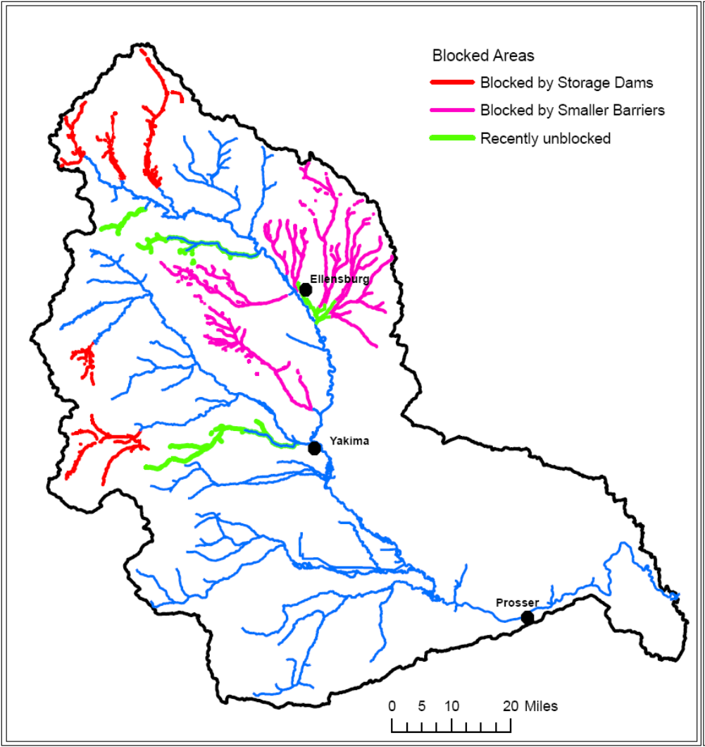
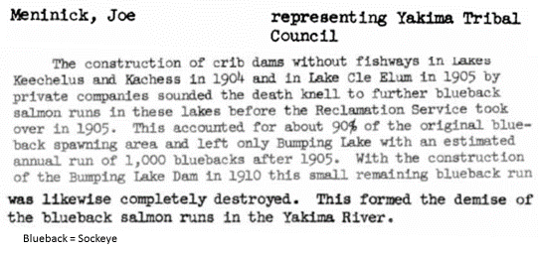
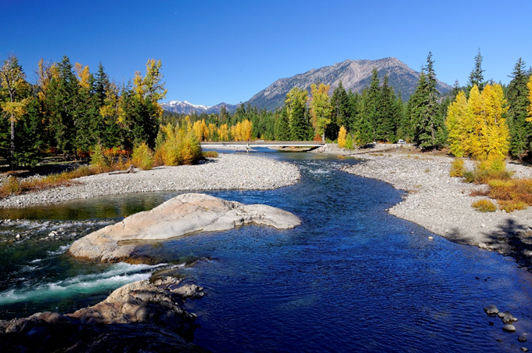
The Reservoirs
All five Yakima Project storage dams completely blocked fish passage for salmon, steelhead, and bull trout.
Four were built on natural lakes that hosted sockeye, which were extirpated in the basin
Habitat Above Cle Elum Dam

Slide 40
Two Flavors of Treaty Rights
Winters Rights
Right for water to fulfill purpose of Reservation
Priority date generally date of Treaty
Winans et al.
Tribes retained right to fish etc. in ceded lands
Right to access fishing sites (easement)

Slide 41
Winters v. United States (1908): On-reservation water rights survived statehood
Non-Indian irrigators diverted Milk River upstream of Ft. Belknap Reservation.
U.S. sued to protect Treaty reserved right to on-reservation irrigation water.
Non-Indians claimed
a) water was given up by the Indians
b) or alternatively, if water was reserved in Treaty (May 1888), the reservation was repealed by Montana statehood (Feb. 1889) (without telling the Tribe, of course)

Slide 42
Winters
Court Found - Where land was reserved for an Indian Tribe:
1) there was an implied reservation of the water necessary to carry out the purposes of the reservation
2) the reserved water is not subject to the prior appropriation rules of the state
...it would be extreme to believe within a year Congress destroyed the reservation and took from the Indians the consideration of their grant, leaving them a barren waste--took from them the means of continuing their old habits, yet did not leave them the power to change to new ones.

Slide 43
Double standard:
Nobody challenges the claims to 1880 priority date for water rights established in the territory prior to statehood, but there have been plenty of challenges to the Indian claims of water rights that were established before statehood.

Slide 44
US vs. Winans (1905): State can not give away treaty rights
Winans brothers operated state licensed fish wheels adjacent to federal homestead patents
 Winans invoked these authorizations to keep Yakamas from fishing at Celilo
 Court found
1) Fishing rights the Indians had kept for themselves in the Stevens treaties (of which Yakama is one) could not be taken away by state license or federal grants
2) access is guaranteed by Treaty. the Indians were given a right in the land...(the Treaty) fixes in the land such easements as enables the (fishing) right to be exercised.

Slide 45
So That’s The End Of It, Right?
Sadly, no.
A century (so far) of litigation to get states to comply with “supreme law of the land”
U.S. v. Washington (Boldt Decision, 1974): Off Reservation rights to take fish survived statehood
U.S. v. Washington - Phase II
State’s parking lot habitat argument
U.S. v. Oregon
A hatchery fish is a fish

Slide 46
Better Litigate Than Never
Modern catch phrase: Litigation equals failure
Most (all?) of state recognition of Treaty Rights that Tribes know today came through litigation
Governor, I have been arrested well over 100 times, I am very familiar with Washington State’s court system - Billy Frank

Slide 47
Salmonscam: On trial for fishing
30 years after 'salmon scam' trial, David Sohappy is still on the river
http://www.yakimaherald.com/years-after-salmon-scam-trial-david-sohappy-is-still-on/article_5dc2f63e-27d6-11e7-9b2f-276b99f27bf6.html

Slide 48
Why did the state stop arresting Indians for fishing under their Treaty Rights?
Consensus? Enlightenment?
No, the U.S. courts told WA to knock it off
Washington State compliance was what one appellate judge termed
except for some desegregation cases...the most concerted official and private efforts to frustrate a decree of a federal court witnessed in this century.

Slide 49
Supremes Upheld Boldt
1) Treaty negotiators promised and Indians understood that they would be able to “forever continue” off reservation food gathering and fishing.
2) Promise to protect this food source was “crucial in obtaining the Indians” assent.
3) Trend of excluding Indians from fishery was encouraged by “often discriminatory state regulation”.
4) Widespread defiance of lower court order.

Slide 50
Where to Learn More
http://www.ccrh.org/comm/river/legal.htm

Slide 51
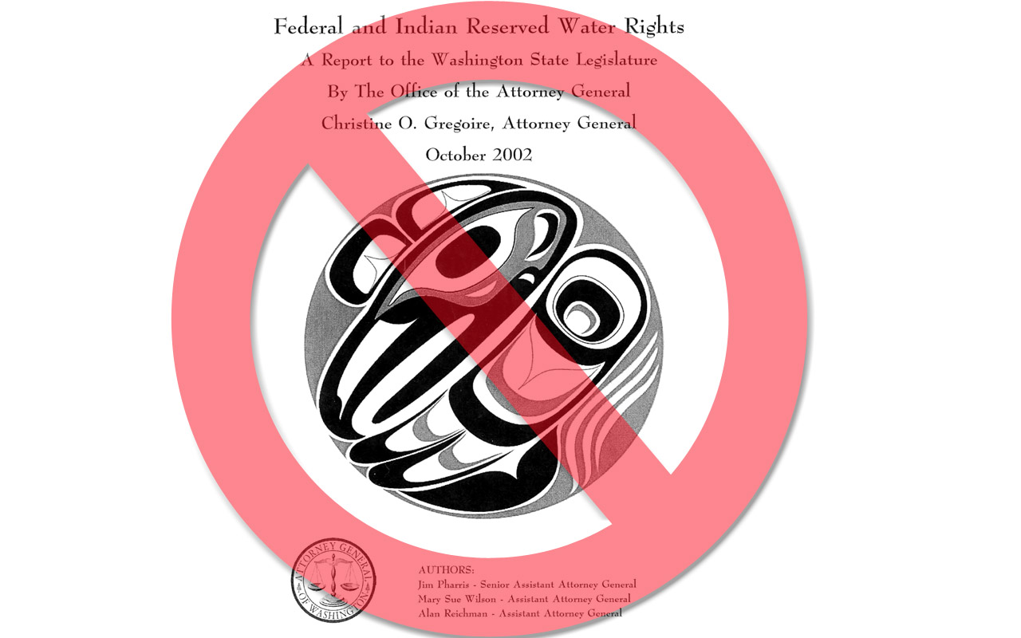
Where
Not
To
Learn
More

Slide 52
Come On, Say It, It’s A Water Right
AG report questions “extent to which a treaty fishing right implies a federally protected water right in specific off-reservation surface water bodies such as an instream flow right to maintain fish.”
“The existence of such rights is clearly implied by such cases as …(“Acquavella II”)…, but the precise nature and extent of such rights have not been conclusively determined”.

Slide 53
But isn’t the purpose of an adjudication…?
Remarkably, the discussion fails to mention the fact that the Washington Supreme Court has recognized a Treaty right to water for instream flows for salmon habitat. On remand, the Superior Court explicitly held that, although diminished by federal actions, the Yakama Nation’s instream flow right extended off the reservation to support usual and accustomed fisheries.
Robert Anderson, UW Law School

Slide 54
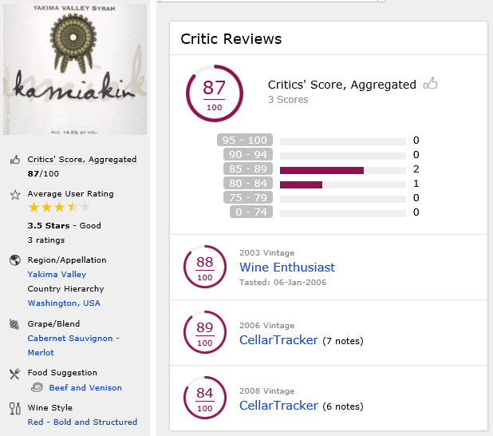
Epilog Time Immemorial to 2017 The Wrath of Grapes Homage to the First Irrigator A Yakima Valley Syrah Red and Bold
We will take questions after Tom M. speaks
https://www.wine-searcher.com/wine-101198-0001-sheridan-vineyard-kamiakin-red-yakima-valley-usa

