Slide 1
Is the past a way to our future? Adjudication and Reallocation
Bob Barwin, free agent and dinosaur
Washington State AWRA Annual Conference, October 3, 2017

Slide 2
Timeline - Legislation
Water Code Enacted - 1917
Adjudication - RCW 90.03.110-245
Claims registration enacted - 1967
RCW 90.14
Required pre-code water users or riparian claimants to document their claims and file in the state registry
Forfeiture of right for unexcused non-use
Water Resources Act Enacted - 1971
RCW 90.54
Allocate water to secure the maximum net benefits
Retain base flows on all perennial streams and rivers
Maintain high water quality
Changes and Transfer – RCW 90.03.380
Condemnation for higher and better use – RCW 90.03.040

Slide 3
Adjudication
A small fraction of pre-code water right claims were adjudicated by 1930.
  Walla Walla and Dungeness were the largest basins adjudicated; many upper Columbia tributaries were adjudicated
  The Great Depression and WWII halted what was up to then a successful effort
Adjudication activity returned in the late 1960s
In 1977, the Yakima adjudication was filed.
From 1967-1990 about 8 small adjudications were completed.
  Bonaparte Cr., Wolf Cr., Antoine Cr., Chumstick Cr., Cow Cr., L. Klickitat R. and Blockhouse Cr., and Duck Lake Sub-area

Slide 4
Water Right Claims Registration Act
1967 – 50th Anniversary of the 1917 Water Code!
How can you adjudicate pre-code claims decades later without knowledgeable witnesses?
  Require all entities claiming the right to use surface water prior to 1917 under state law** to file a statement describing their claim by 1974
Failure to file a claim constituted forfeiture
Relinquishment or forfeiture for unexcused non-use of the claim or right first introduced to the water code
** Rights established under federal law such as Winters or Walton or RCW 90.05 (USBR) not included

Slide 5
Instream flows as a Reallocation Incentive
Instream Flow rules
Priority date of the instream flow right is set by rule adoption date
Subsequent decisions reflect the existence of the adopted flows as a water right to be protected
Conditioned Permits
New permits are subject to interruption
Permitting complexity was simplified
Enforcement
Program to cost-effectively monitor and enforce was needed
Piloted in Methow and Okanogan in 1985 and later refined for use in Wenatchee and mainstem Columbia.
It changed the way permittees viewed their new permits
Permit management was more complicated

Slide 6
Administration – transparency facilitates reallocation
Prior to 1974, water right claims weren’t documented unless they had been adjudicated
Prior to early 1980s, claims information was largely unavailable to permitting staff
Applicants often sought new permits rather than changing existing rights
  Ecology permits writers had little information on water right claims and, consequently, would defer to applicant’s decision to apply for a new permit
By 1985, claims had been imaged and copies of the tapes and cassette readers were made available to permitting staff
By 2000, GIS tools allowed spatial mapping of water right PODs and POU
By 2005 well log and water right data was made available via Ecology’s website

Slide 7
Administration - Conservancy Boards
RCW 90.80
Pilot enacted in 1997; fully enacted in 2001
  “Voluntary water right transfers can reallocate water use in a manner that will result in more efficient use of water resources”
  “Voluntary water right transfers can help alleviate water shortages, save capital outlays, reduce development costs, and provide an incentive for investment in water conservation efforts by water right holders”
Grant
Kittitas
Klickitat
Lewis
Lincoln
Okanogan
Spokane
Adams
Benton
Chelan
Douglas
Franklin
Stevens
Thurston
Walla Walla
Whitman
Yakima

Slide 8
Washington’s Water Right Acquisition Program
1989 - RCW 90.38
Yakima River Basin
Support for Yakima River Basin Water Enhancement Program
1991 - RCW 90.42
Statewide
Authority to hold and manage water rights for any beneficial purpose
Water banking added in 2002, following successful Yakima Basin and Columbia mainstem drought response water banking programs in 2001
2001-2015 Capital Appropriations
Flow Improvement
Irrigation Efficiencies Grant Program

Slide 9
Water acquisition, transaction types
The department may enter into leases, contracts, or such other arrangements with other persons or entities as appropriate, to ensure that trust water rights acquired in accordance with this chapter may be exercised to the fullest possible extent. – RCW 90.42.080

Slide 10
Water acquisitions
Agreement type | Funded amount | Primary Reach | Secondary Reach, ac-ft/yr
Diversion Reduction | $1,868,188 | Yes | Yes
IEGP | $16,200,218 | Yes | Possible
Lease | $20,716,975 | Yes | Yes
Other | $21,742,587 | Yes | Yes
Purchase | $25,654,930 | Yes | Yes
 | $84,314,710 | 811,389 ac-ft/yr | 26,749 ac-ft/yr

Slide 11
Where have water rights been permanently acquired?
River Basin | Primary Reach, ac-ft/yr | Secondary Reach, ac-ft/yr
Dungeness, WRIA 18 | 2445
Walla Walla, WRIA 32 | 10557 | 2546
Tieton River, WRIA 38 | 1832 | 1370
Upper Yakima, WRIA 39 | 19210 | 4017
Lower Yakima, WRIA 37 | 68611 | 401
Methow, WRIA 48 | 8044 | 3231
Wenatchee, WRIA 45 | 8183 | 19
% of statewide total* | 98.5% | 66%
Total | 118,882 | 11,584
* Doesn’t include USBR/Lake Roosevelt, Lake Tapps, or Sullivan Lake agreements

Slide 12
Institutional Water Banks using the Trust Water Right Program
Water banks are used to distribute mitigation credits to enable new water uses or to facilitate transfers, or both
  Walla Walla River
  Yakima River Basin
  Dungeness River
  Columbia River mainstem
  Methow River (MVID)
It should NOT be surprising that water banks operate in the same basins where the most public investment to restore instream flows has been directed

Slide 13
Columbia River Water Supply and Development Program – RCW 90.90
Enacted in 2006
It’s a form of institutional water right bank
  It credits both tributary and mainstem flow benefits
  It can generate habitat improvement in tributaries
  It debits mainstem water allocation
  It uses a consultation process; has a hard floor (the adopted instream flows)
Bond authority of $200 million to pursue water supply development
Responded to 15 years of litigation and permitting frustration
  Ecology and the National Research Council separately determined the mainstem Columbia was over-committed in the July-August period

Slide 14
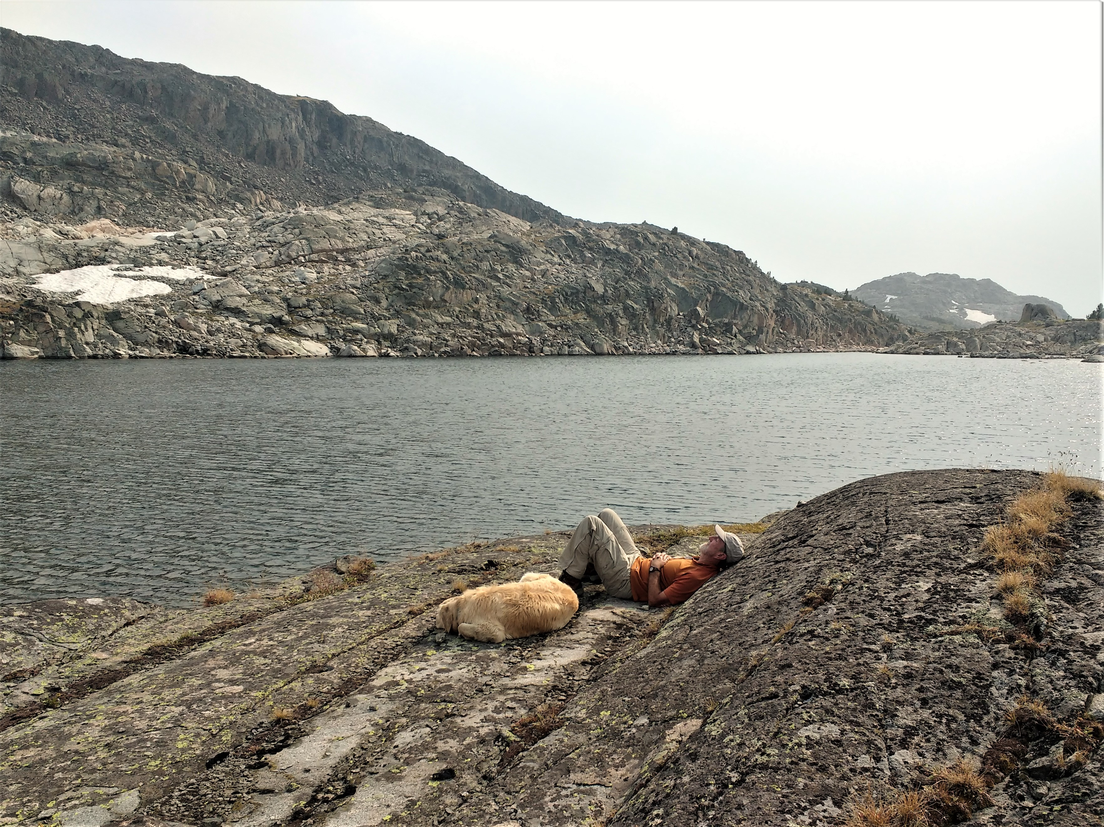
Water rights based on prior appropriation can evolve to be part of the future.
“I don't know much about history, and I wouldn't give a nickel for all the history in the world. History is more or less bunk. It is a tradition. We want to live in the present, and the only history that is worth a tinker's damn is the history we make today.” ~Henry Ford

Slide 15
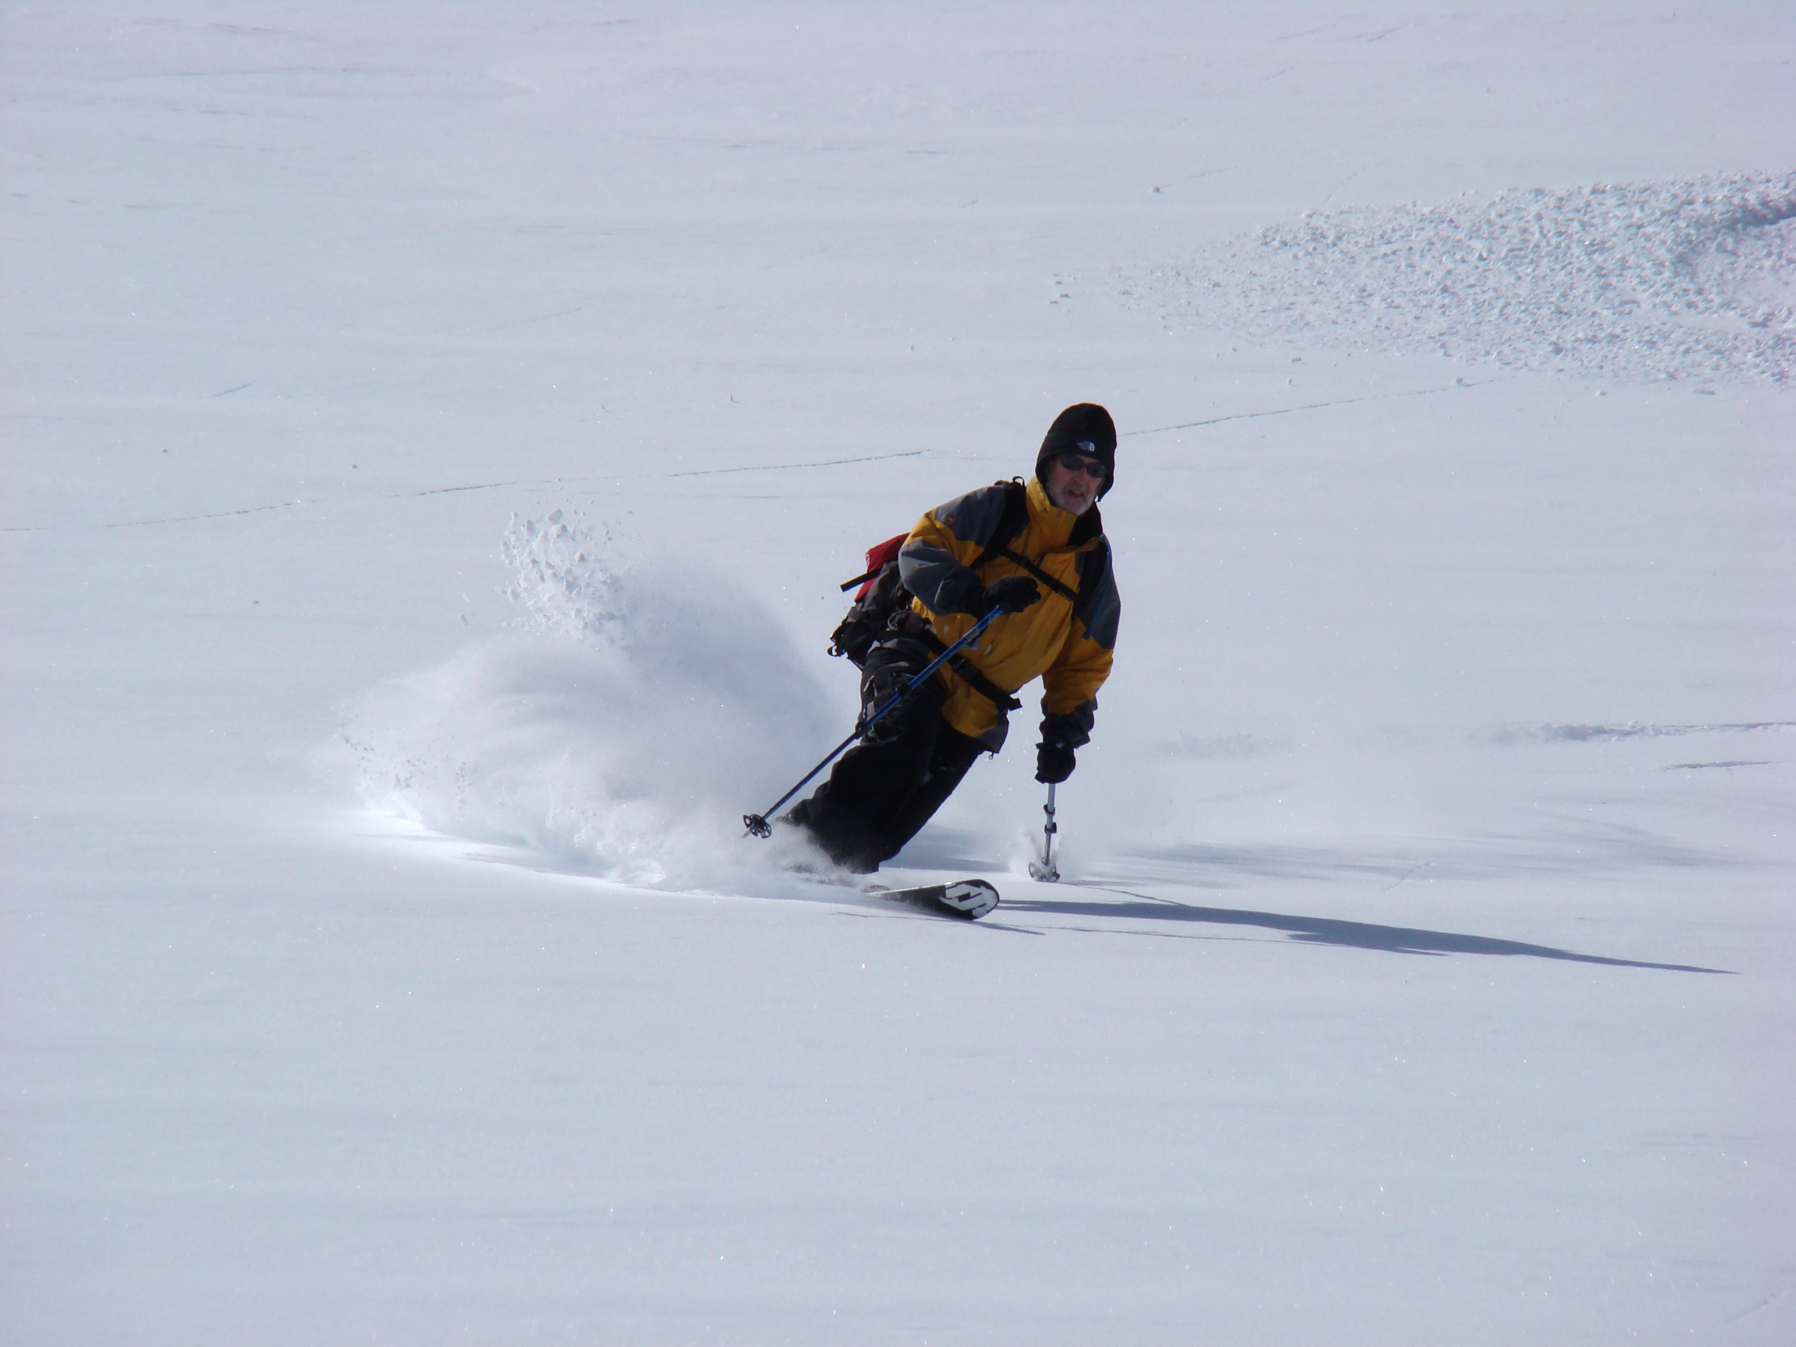
Use inertia and momentum, reduce uncertainty…
…and make adjustments!

