Slide 1
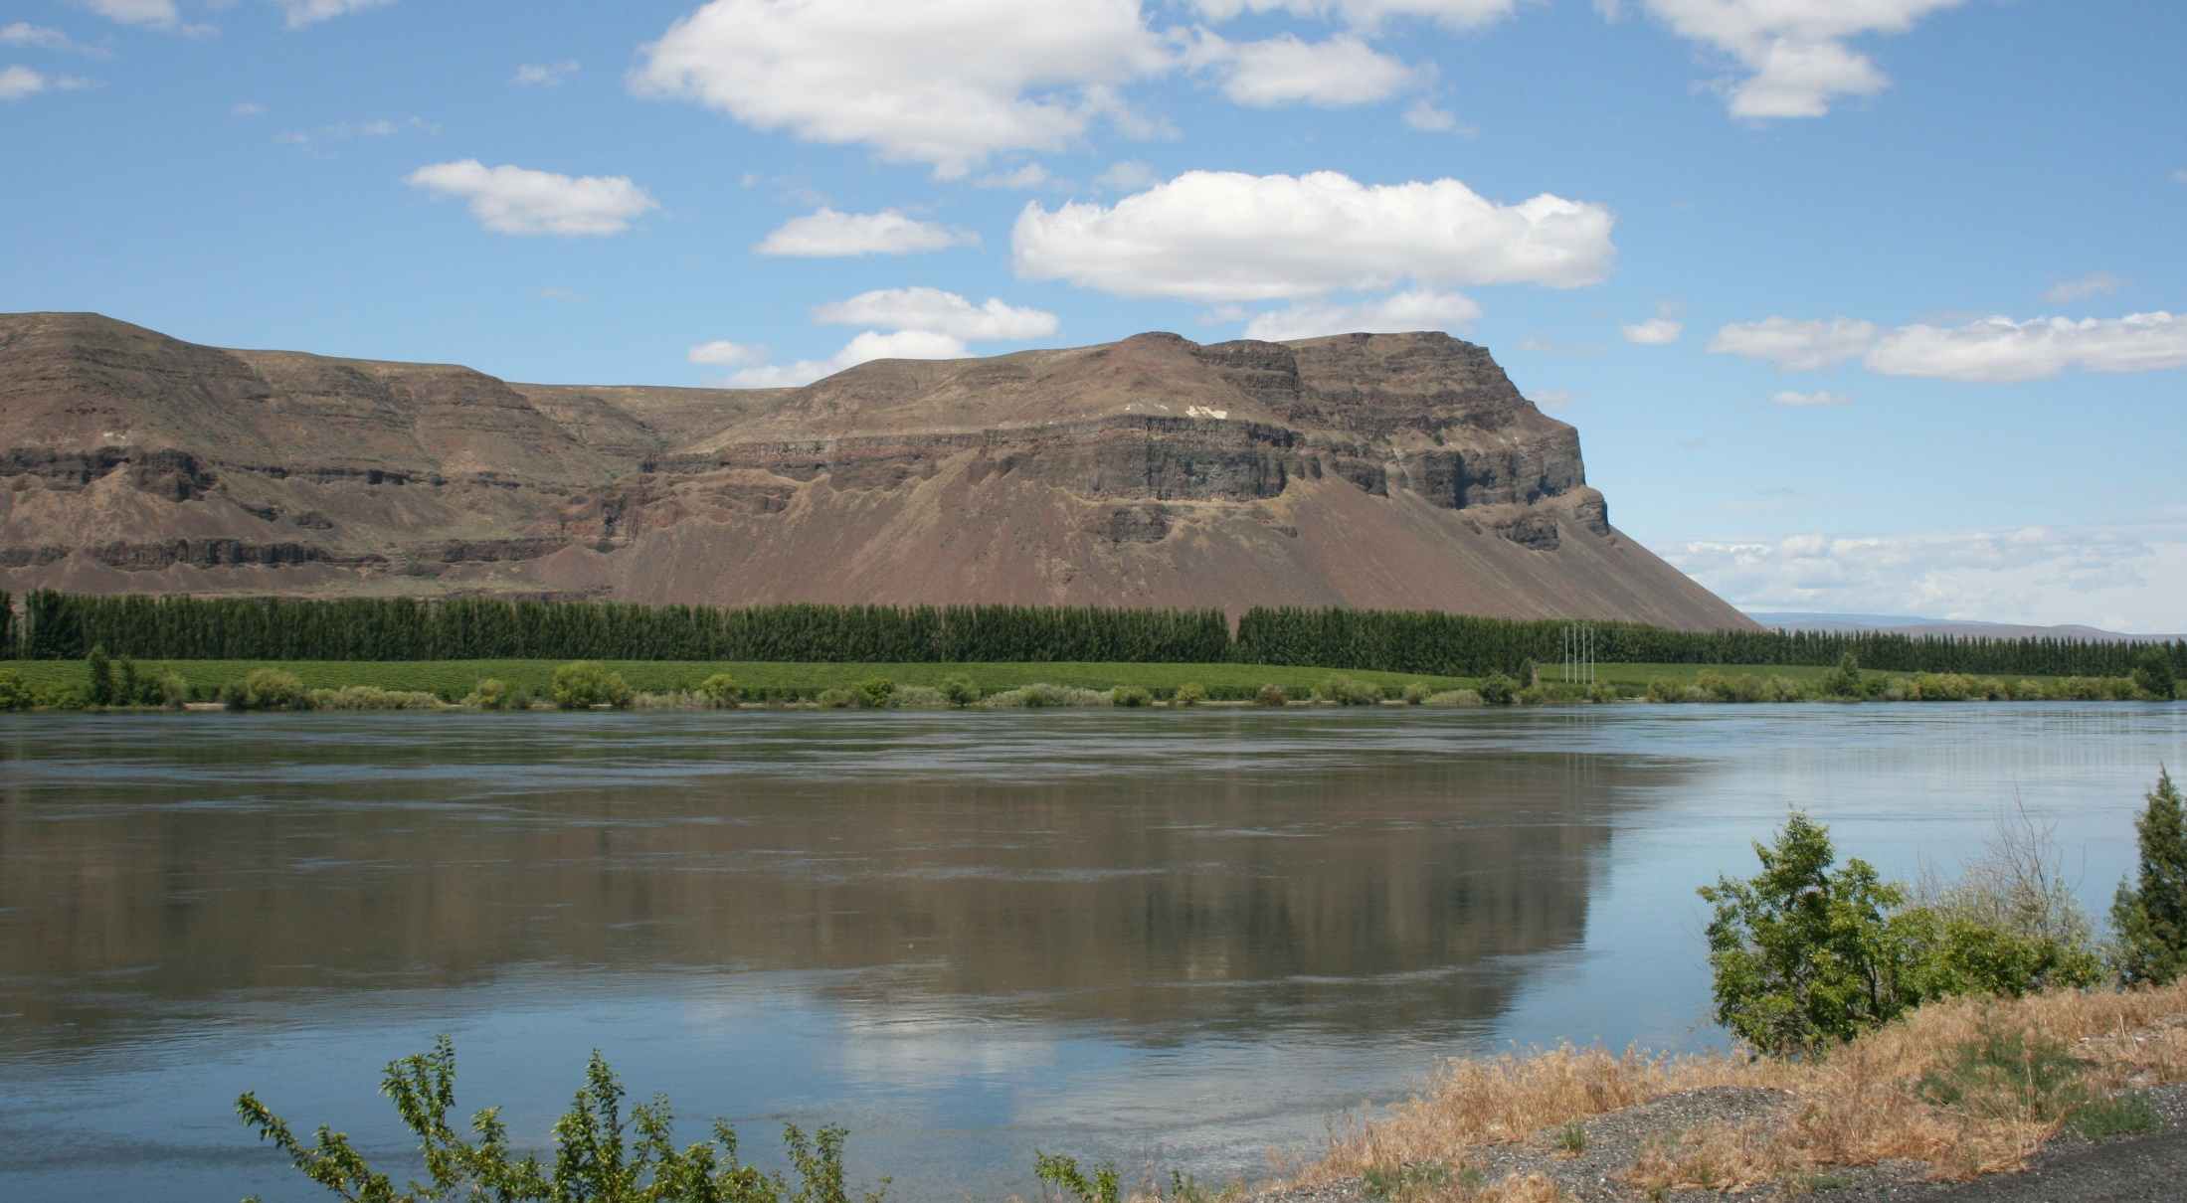




COLUMBIA RIVER BASIN 2016 LONG-TERM WATER SUPPLY & DEMAND FORECAST
Presented by:
Jennifer Adam
Associate Professor (WSU Civil and Environmental Engineering)
Associate Director (State of Washington Water Research Center)

Slide 2
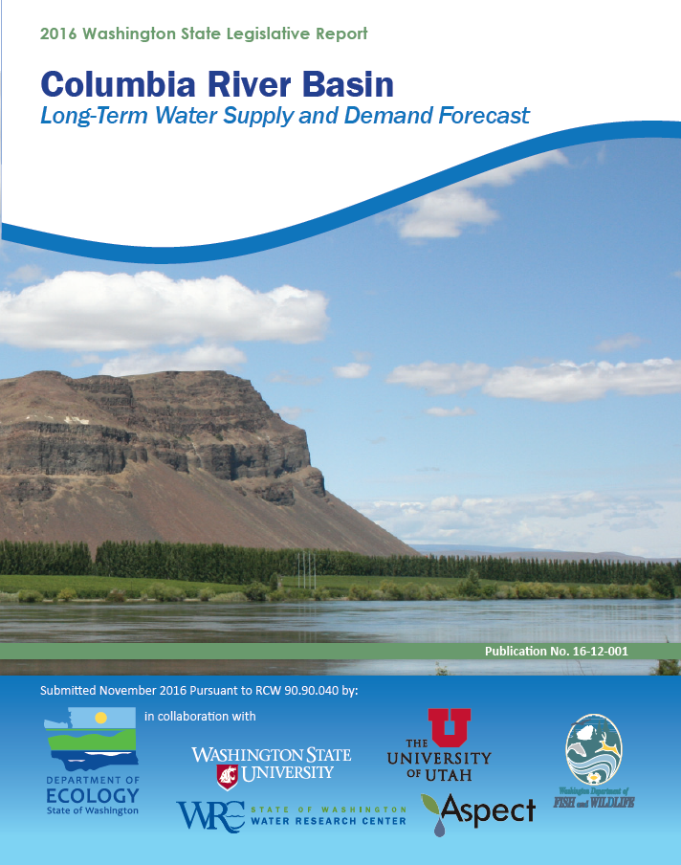
Background
Every 5 years, the Washington State Department of Ecology’s Office of the Columbia River (OCR) is required to submit a long-term (20-year) water supply and demand forecast to the State Legislature
Washington State University (WSU) was assigned to develop the forecast for water supply and out-of-stream demand
The forecast helps improve understanding of where additional water supply is most critically needed, now and in the future

Slide 3
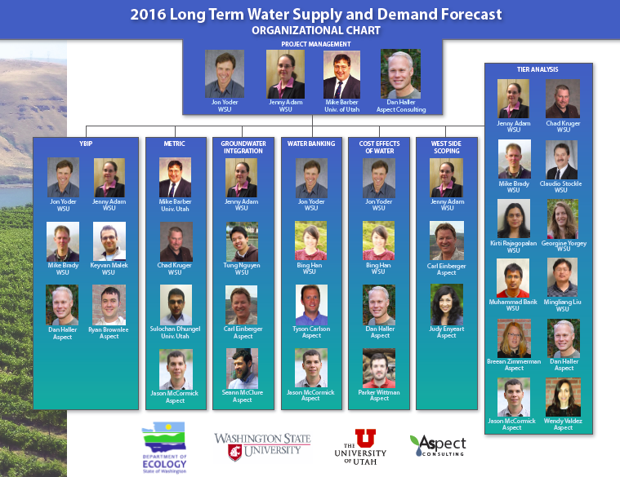

Slide 4
Improvements for the 2016 Forecast
Forecast through 2035
Improved hydrology, cropping models, consumptive loss simulation
Utilized improved WSDA cropping data
Utilized improved climate change projections
Improvements in ability to capture water rights curtailment and Yakima Basin pro-rationing

Slide 5
Approach
Biophysical Modeling of Water Supply and Irrigation Demand
Economic Modeling of Future Crop Mix
Municipal Demand
Hydropower Demand
Complexity

Slide 6
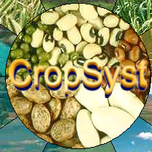
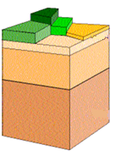
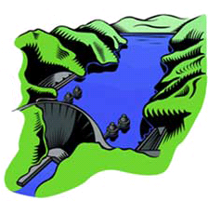
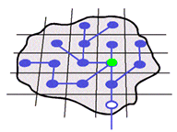
Biophysical Modeling:
Overview of Framework
I. Coupled simulation of hydrologic cycle and crop growth:
all irrigation requirements met
II. Runoff, baseflow, and return flow routed through flow network; reservoir simulation accounts for irrigation diversions
VIC
ColSim
or Yakima-RiverWare
IV. Iteration of coupled simulation to account for reduced irrigation in dry years
III. Irrigation and municipal diversions compared to water availability and instream flow requirements; curtailment in dry years

Slide 7
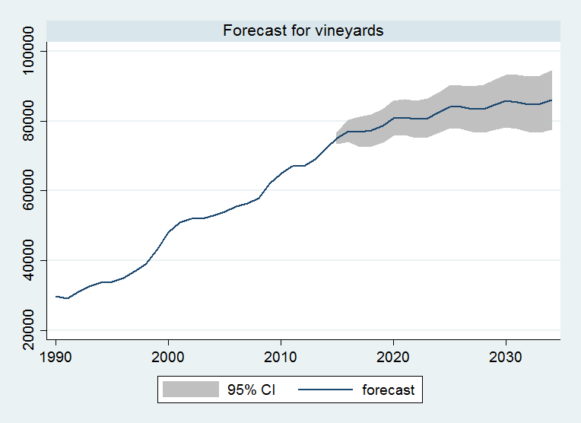
Economic Modeling:
Forecasting Future Crop Mix
Changes in crop mix can affect overall water demand due to differences in crop water requirements.
Data on recent trends in the irrigated crop mix in Eastern Washington were used in a statistical model to forecast future crop mix.
This approach has been shown to produce more accurate forecasts than complex economic models.
Courtesy Michael Brady, WSU

Slide 8
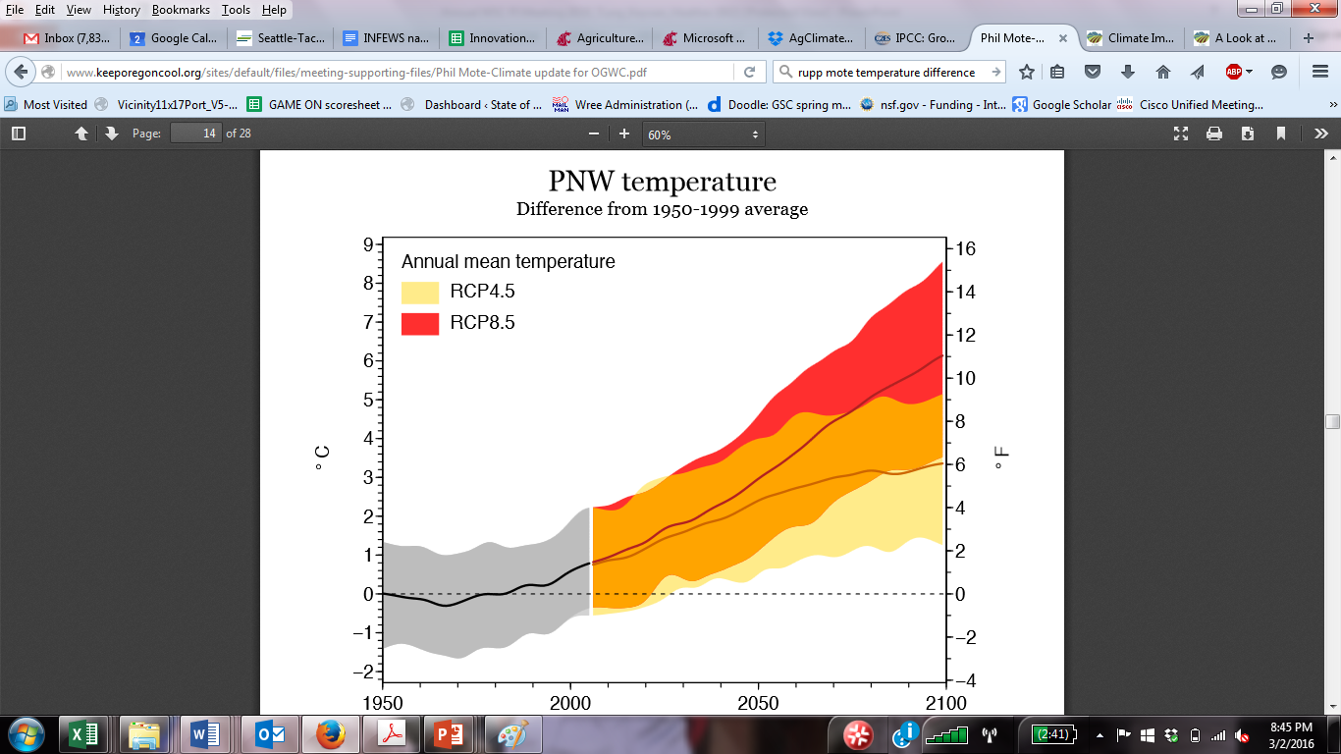
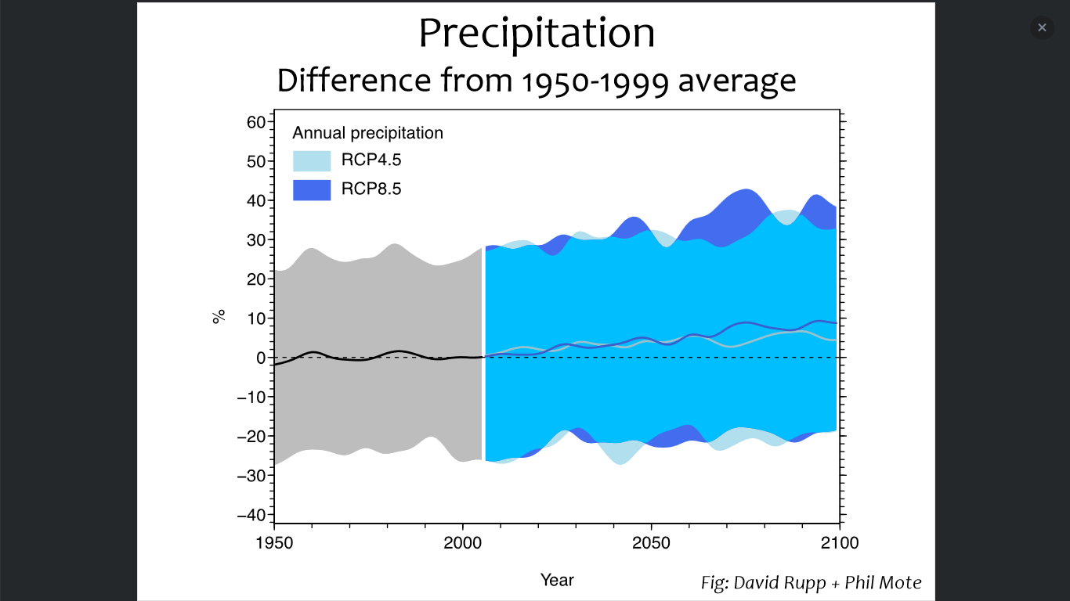
Overview of Integrated Modeling:
Projected Climate in the Pacific Northwest
Greenhouse Gas Concentrations Increasing
Temperature
  Annual temperature increase
  Summer increases are greater than other seasons
Precipitation
  Annual precipitation: most projections suggest a slight increase
  Summer precipitation decreases; other seasons increase
  Five future climate scenarios for each greenhouse gas increase
Rupp et al. 2016
Precipitation

Slide 9
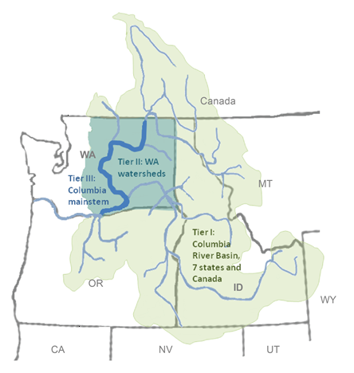
Results

Slide 10
Summary of Changes in CRB Water Supply and Demand (2030s Ensemble Mean)
Supply:
  Average annual increase: +14.6% (+/-8.3%)
  Average shift in seasonality:
Demand:
  Average decrease in eastern WA irrigation demand:
    -5.1% (+/-1.0%) (historical crop mix)
    -6.9% (+/-1.0%) (future crop mix)
  Average shift in seasonality (future crop mix):
-10.3% (+/-7.9%) between June and October
30.8% (+/-9.4%) between November and May
5.7% between March and June
-13.3% between July and October
Hall et al. 2016

Slide 11
Causes of Projected Decrease in Irrigation Demand
In Response to Climate Change
Water Supply: Springs are getting wetter
Water Demand: Shifting of irrigation requirements earlier in the season
  Earlier planting and shorter irrigation season for most crops
  Higher water-use efficiencies due to increases in CO₂
In Response to Economic Drivers
Shift towards more water-use efficient crops
Note that many adaptive actions were not considered
Increases in double/cover cropping
More slowly-maturing crop varieties (e.g., corn)
Expanded irrigated acreage
Changes in irrigation technology/management

Slide 12
Columbia River Basin: Regulated Supply and Demand
Note: Supply is reported prior to accounting for demands
Results for median condition averaged
across Climate Scenarios:
Supply increased by 16.8%
Irrigation demand decreased by 4.9%
Note that supply and demand results were quantified for low, medium, and high values due to year-to-year variability

Slide 13
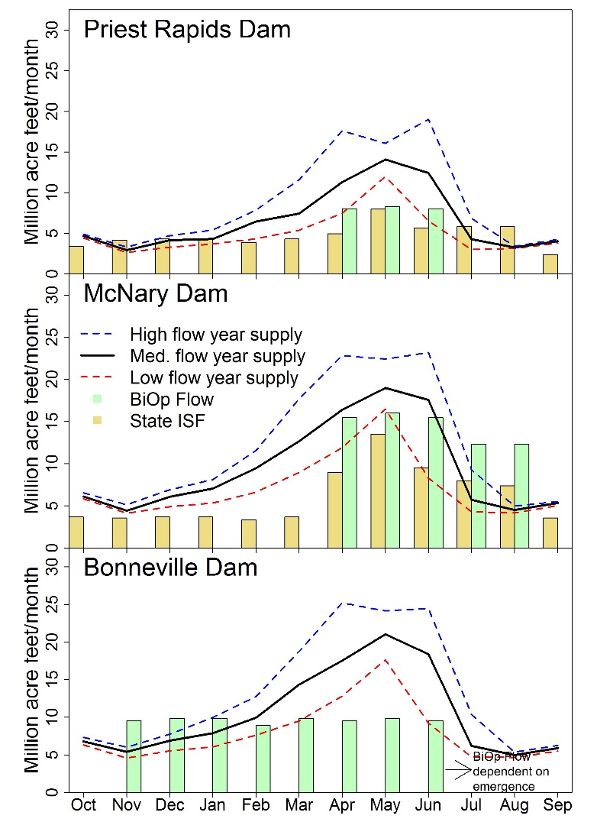
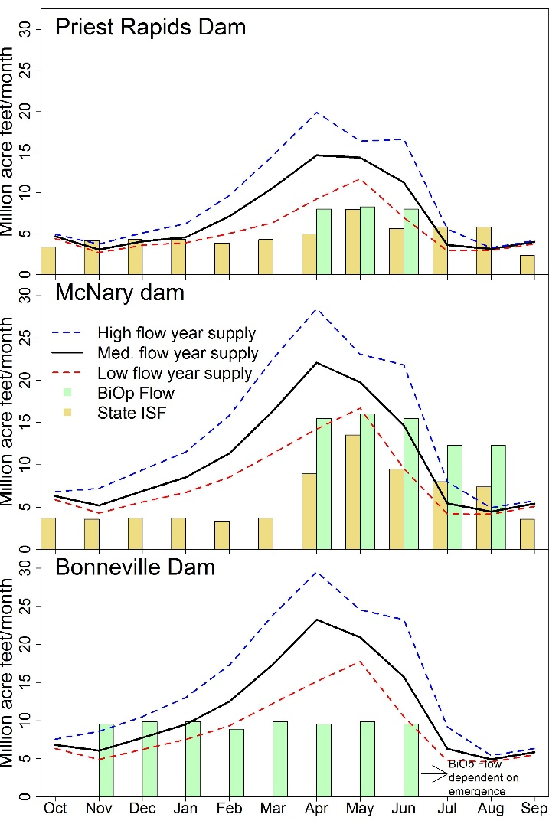
Mainstem: Regulated Supply and Instream Flow Requirements at Key Locations
Historic
Future
Note: Mid-Range Climate Scenario; Supply is reported prior to accounting for demands

Slide 14
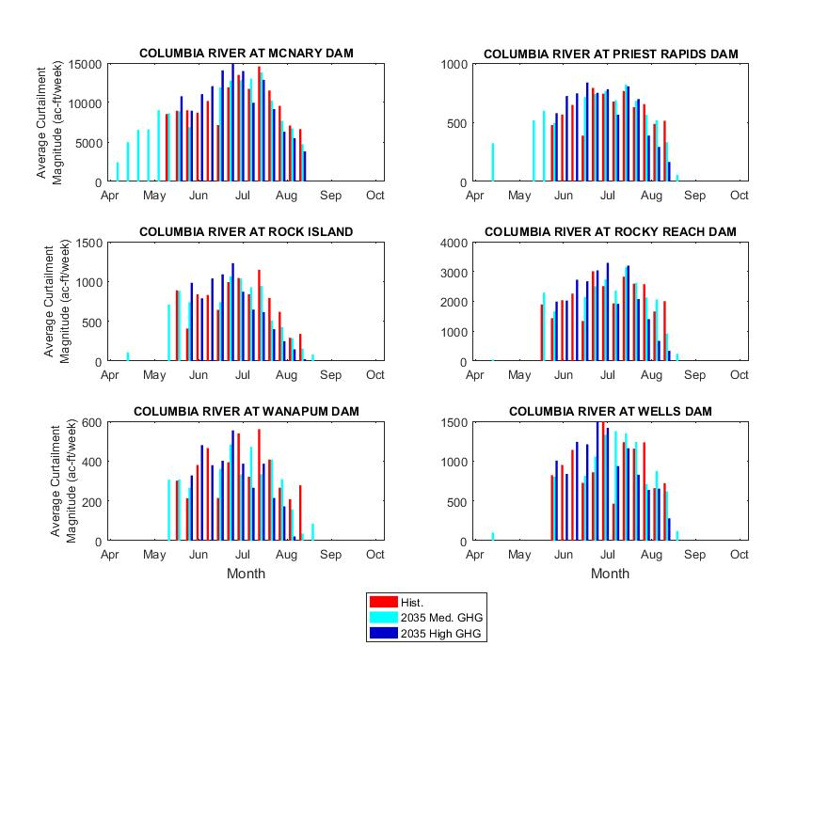
Columbia Mainstem Curtailment

Slide 15
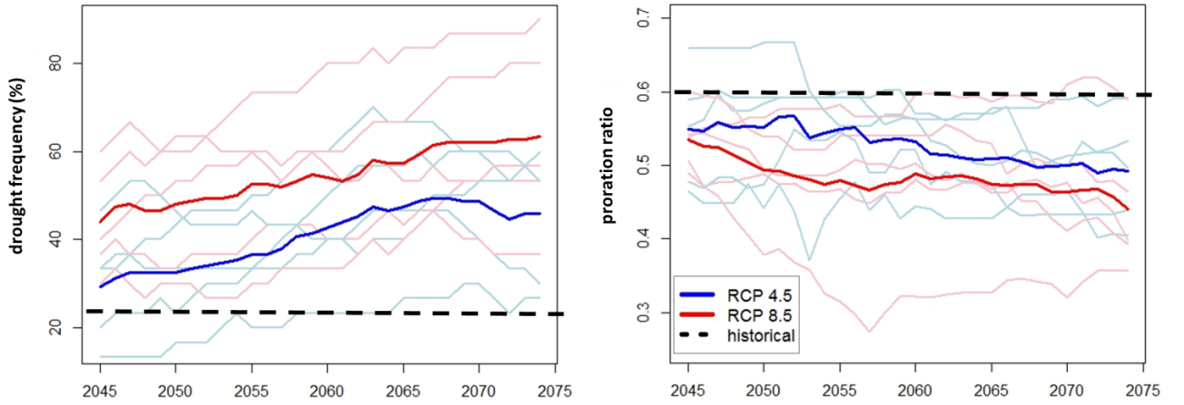
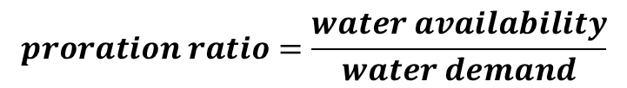
Impacts on Proration Ratios in the Yakima River Basin
Proration Ratio = Percent of Water Right Allowed for Irrigation Season
Malek et al. (WRR, in prep.)

Slide 16
Some Key Uncertainties and Data Gaps (not comprehensive)
Current Conditions
Extent of current double and cover cropping
Limitations with water rights information; not all categories of water rights were modeled
Treatment of areas with declining groundwater levels
Future Conditions
Response of crops to CO₂ fertilization, esp. tree fruit
New water rights being granted – expansion of irrigated extent
Future areas with declining groundwater levels
Adaptive actions that may either alleviate or exacerbate water constraints

Slide 17
Summary of Impacts
Climate Change: Climate change is associated with warming, changes in precipitation seasonality, changes in the frequency of extreme events, and increases in CO₂
Water Supply: While changes in annual water availability is uncertain, availability will decrease during the later stages of the growing season without adequate reservoir storage
Water Demand: Irrigation water demand may increase or decrease depending on producer actions taken; it will also shift earlier in the growing season
Uncertainties: Adaptation actions may alleviate impacts for some users at the expense of other users

Slide 18
Questions?

Slide 19
2016 Forecast: Summary of Water Demand Results
Water Use or Need | Estimated Volume (AF) (average of climate scenarios)
Projected changes in Eastern WA Agricultural Demand by 2035 | -332,837 to -250,027
Projected changes in Agricultural Demand by 2035 with 10% Double Cropping | -272,837 to -130,027
Projected changes in Agricultural Demand by 2035 with 10% Double Cropping and Planned Water Supply Projects | 27,163 to 169,973
Projected changes in Eastern WA Municipal and Domestic Demand (including municipally-supplied commercial) by 2035 | 80,000
Projected changes in CRB Hydropower Demand by 2035 | 35,000 to 75,000
Notes:
Additional agricultural demands were modeled assuming the land base for irrigated agriculture remains constant, and climate change is moderate (RCP 4.5 scenario). Projected changes in irrigation demand were estimated as a decrease of 272,100 ac-ft, with a confidence interval of ±29,200 ac-ft. The confidence interval reflects that, though we cannot be sure the projected change is exactly -272,100 ac-ft, we are 90% certain that the value will lie between -301,300 (-272,100 minus 29,200) and -242,200 (-292,100 plus 29,200). These decreases in demand were due to the combined impacts of climate change (wetter in the early growing season) and crop mix (projected shift to crops that use less water). Hydropower projections are based on an average need of 2,200 to 4,800 MW by 2035. This demand is historically expressed as a nonconsumptive water use. Net power generation and water right data for Grand Coulee, Rocky Reach, Rock Island and Lake Chelan were averaged to develop an approximate power-to-water conversion factor of approximately 16 ac-ft/MW. Because this projection is based on existing dams as opposed to new projects, and because these average numbers do not account for peak power needs, actual demand may be higher. Alternatively, if this demand is met via conservation, efficiency improvements, or non-hydro sources, the demand projections could be lower. Unmet Columbia River instream flows are the calculated deficit between instream flows specified in Washington Administrative Code (WAC) and actual flows at McNary Dam in 2001 under drought conditions. 2001 is the only year when Columbia River flows were not met and interruptible water users were curtailed. Unmet tributary instream flows are the combined deficits between current instream flows specified in WAC and actual flows for the driest year on record at the following locations: Walla Walla River at East Detour Road, Wenatchee River at Monitor, Entiat River near Entiat, Methow River near Pateros, Okanogan River at Malott, Little Spokane River at Dartford, Spokane River at Spokane, Colville River at Kettle Falls. All deficits are for drought year 2001, with the exception of the Little Spokane and Colville Rivers, where the greatest unmet flows were in 1992, and the Walla Walla River, where data collection started in 2007. Data on the 2015 drought year are being evaluated, to determine whether 2015 should be used to adjust this estimate for the final report. Multiple water projects planned in the Yakima River Basin, as part of the Yakima Integrated Water Resource Management Plan, are expected to lead to decreases in the estimated volume needed by the 2021 Forecast. Examples include: Yakima Aquifer Storage and Recovery (ASR), Cle Elum Reservoir, and the Kachess Drought Relief Pumping Plant. Reports of Examination state that 164,000 ac-ft are needed to serve 70,000 acres. The East Columbia Basin Irrigation District is currently serving 3,000 acres of groudwater replacement via the Columbia Basin Project. Assuming these acres are served with an average 3 ac-ft/ac, the volume still needed was estimated. Two additional sources are expected to contribute to this alternate supply, the Odessa Subarea Special Study and the Lake Roosevelt Incremental Storage Releases Program. As the contributions of these two additional sources were not quantified at the time of this report, the volume estimated here should be considered a conservative estimate. This estimated need was calculated on the following basis: approximately 230,000 acres of irrigated under water rights within areas affected by unreliable and/or declining groundwater supplies, an assumed average irrigation rate of 3 ac-ft/ac, and an approximate affected population of 200,000 with an average use of 200 gpcd. This estimate does not include the Odessa Subarea. Significant uncertainty exists in this estimate related to the geographic extent of the affected areas and other factors.

