Slide 1
AWRA Washington State Conference October 3, 2017
Identifying Possible Solutions:
Legal Water Right Certainty
Alan Reichman, Senior Counsel
Office of the Attorney General of
Washington

Slide 2
WHY ADJUDICATE?
Period of “soul searching” in Washington over whether water rights adjudications are necessary and worth the considerable costs.
Triggered by the impending conclusion of Acquavella: the adjudication of surface water rights in the Yakima River Basin.

Slide 3
WHY ADJUDICATE?
Triggered by 100th Anniversary of the Washington Water Code, which was enacted in 1917 and established the adjudication process.
Are the benefits gained from Acquavella worth the costs?
Should water rights adjudications be commenced in other river basins?

Slide 4
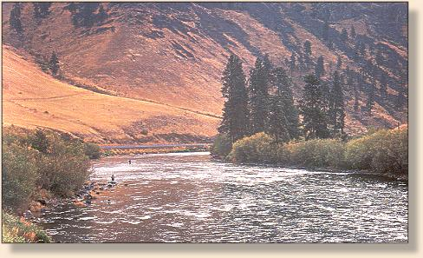
WHY ADJUDICATE?
Are the benefits gained from Acquavella significant enough to justify future adjudications that would clarify water rights in basins throughout Washington?
Are there ways to do adjudications more efficiently?

Slide 5
WHY ADJUDICATE?
1917 Water Code and 1945 Groundwater Code established water rights permitting system.
Water Rights established prior to enactment of the codes could be preserved through the filing of water rights claims.
Adjudication is the way to determine the validity and extent of pre-code water rights documented by claim forms.

Slide 6
WHY ADJUDICATE?
Adjudication is needed to be able to regulate between pre-code rights and rights established through the permit system based on priority dates.
Under McCarran Amendment, 43 U.S.C. § 666 (1952), a general adjudication in state court can include determination of water rights held by the federal government and tribes. Waiver of sovereign immunity.

Slide 7
WASHINGTON ADJUDICATIONS
82 completed adjudications. Decrees range from 1918 to 1990. Most are for small basins, and most were completed in era within 20 years after enactment of the 1917 Water Code.
Six adjudications were started but remain incomplete for various reasons.
There are approximately 170,000 unadjudicated water rights claims.

Slide 8
WHY DID ACQUAVELLA START IN THE FIRST PLACE?
Filed in 1977 in race to courthouse when U.S. threatened to sue in federal court on behalf of Yakama Nation.
Tension from drought of 1977.
Remanded by federal court back to state court in 1979.

Slide 9
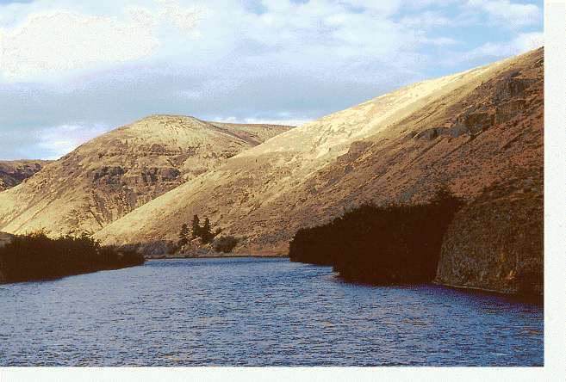
BENEFITS OF ADJUDICATING YAKIMA BASIN WATER RIGHTS
Approximately 4,000 surface water claims, serving 40,000 landowners, and residents of cities. Some claims adjudicated in 1920s, and many never determined and confirmed.
Yakima River and tributaries key to economy, culture, and recreation in basin.

Slide 10
BENEFITS OF ADJUDICATING YAKIMA BASIN WATER RIGHTS
Yakima County is one of the top-ranked counties in U.S. in total agricultural production, and Basin also includes Kittitas and Benton Counties.
Yakima County is the number one county in the nation for production of apples, and for hops.
60 kinds of fruit and vegetables, seed, grain, forage, and specialty crops.
Salmon and steelhead important for culture and recreation.

Slide 11
STATUS OF ACQUAVELLA: CLOSE BUT NOT QUITE THERE YET
Conditional Final Orders (CFOs) for 31 Major Claimants, including U.S. Bureau of Reclamation and major irrigation districts.
CFO determining irrigation rights and instream flow rights for Yakama Nation.
CFOs for thousands of other water right claims in 31 Subbasins, most for tributaries to Yakima River.

Slide 12
STATUS OF ACQUAVELLA: CLOSE BUT NOT QUITE THERE YET
Proposed Final Decree issued on August 10, 2017. Final Decree will integrate the CFOs and earlier court orders in the adjudication.
Process for filing of objections on content of Proposed Final Decree has begun.
Final Decree projected to be issued in Spring 2018. Appeals are possible.

Slide 13
STATUS OF ACQUAVELLA: WHAT HAVE WE GAINED?
CFOs clarify validity and extent of surface water rights in the Yakima Basin.
Determination of federal reserved rights of Yakama Nation. Almost all other tribal reserved rights in Washington are unresolved and unquantified, leaving uncertainty.

Slide 14
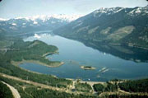
STATUS OF ACQUAVELLA: WHAT HAVE WE GAINED?
Workable system for delivery of water in Yakima Project.
Burgeoning market for water right transfers, e.g. Suncadia Resort.
Case law applicable throughout state and for future adjudications.

Slide 15
WHAT OTHER BASINS COULD BENEFIT FROM ADJUDICATIONS?
Spokane Basin: possibility of interstate dispute with Idaho; uncertainty over validity and extent of large inchoate rights.
Nooksack Basin: Lummi Nation and Nooksack Tribes have asked federal government to sue for determination of tribal rights; concerns over illegal water use.

Slide 16
CAN ADJUDICATIONS BE DONE MORE EFFICIENTLY?
In 2002, Washington Legislature passed bill directing Department of Ecology and AG to prepare report on adjudications process.
Report entitled “Streamlining the Water Rights General Adjudication Process” was issued in December 2002.

Slide 17
CAN ADJUDICATIONS BE DONE MORE EFFICIENTLY?
Key recommendations of report:
* Ecology develops comprehensive information early in process and submits a report to the court at outset of the adjudication.
* Authorize limited specialized adjudications.

Slide 18
CAN ADJUDICATIONS BE DONE MORE EFFICIENTLY?
Key recommendations of report:
* Expand use of mediation.
* Authorize pre-filed testimony.
Legislature passed bill in 2009 to amend adjudications provisions, which included several of the recommendations: Chapter 332, Laws of 2009.

Slide 19
OTHER APPROACHES TO GAIN LEGAL CERTAINTY
In 2002, Legislature established task force “to study judicial and administrative alternatives for resolving water disputes.”
Product was “A Report to the Washington State Legislature from the Water Disputes Task Force,” issued in December 2003.

Slide 20
OTHER APPROACHES TO GAIN LEGAL CERTAINTY
Key recommendation is creation of a water court system, as a branch of the superior court system. Would be comprised of 4 judges in different regions of the state.
Adjudications provide best means of resolving disputes regarding historic claims, but the adjudications process should be improved.

Slide 21
OTHER APPROACHES TO GAIN LEGAL CERTAINTY
Water court or superior court should have authority to perform limited and specialized adjudications among a subset of water right holders, or limited stream reaches or groundwater areas.

Slide 22
OTHER APPROACHES TO GAIN LEGAL CERTAINTY
Resolution of unadjudicated claims for federal and tribal reserved water rights is needed to provide certainty.
Retain existing adjudication process but create incentives to adjudicate in basins with tribal claims by providing special funds for water conservation or delivery projects, and special funding for mediation services.

Slide 23
OTHER APPROACHES TO GAIN LEGAL CERTAINTY
Create a “compact commission” (like the one in Montana) charged with task of negotiating with other sovereigns, including tribes, to resolve claims for federal and tribal reserved rights.

Slide 24
OTHER APPROACHES TO GAIN LEGAL CERTAINTY
Any settlement reached could be entered as part of a decree in a state adjudication, or in federal court as a consent decree after sufficient opportunities for notice, comment and objection by non-parties.

Slide 25
OTHER APPROACHES TO GAIN LEGAL CERTAINTY
While the Legislature passed bill in 2009 to amend RCW 90.03 to streamline the adjudications process, no action has been taken on other recommendations
A bill to establish water court system was introduced but did not advance.

