Slide 1
Conflict Resolution
(or Water Conflict Management and Transformation)
Lynette de Silva
Program in Water Conflict Management and Transformation
Oregon State University
2017 AWRA Washington State Conference / Seattle, Washington / October 3, 2017

Slide 2
Content
What is Conflict Resolution?
What is Water Conflict Management & Transformation?
Skills and Tools
Research Conducted at OSU

Slide 3
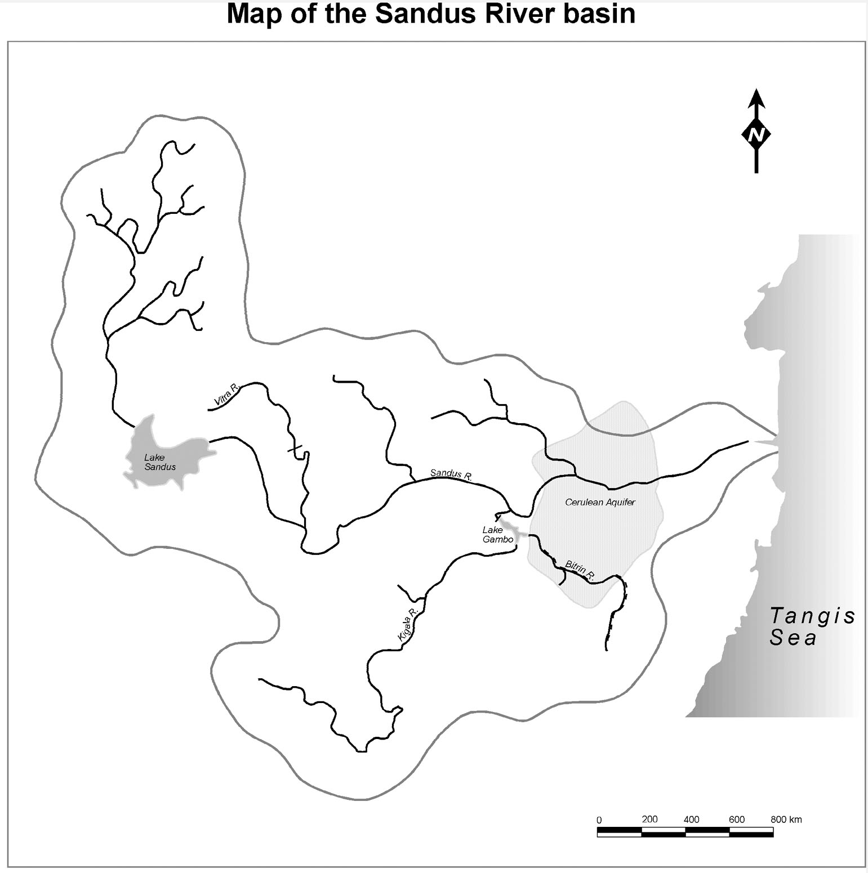
What is Conflict Resolution?
What is Water Conflict Management & Transformation??
What changes when political entities are present?
What capacity do we need to address the change?
What is Conflict…?
Skills and Tools…
Research…

Slide 4
A Narrative Tool: Use Stories
http://www.bookadventurers.com/2014/04/friday-field-notes-040414/
What is Conflict…?
Skills and Tools…
Research…
Notes:
Tell me your rain story
In England, people tend to open a conversations wth strangers with discussion about the weather – neutral topic
When I was about 7-8 I was baffled about the edge of rain I didn’t underatnad how it could be raining on the whole city.
It wasn’t until I was 10, and in the caribbean that I experiences heavy mid day down pours.
What’s your rain story?
If we are going to master rain, we at least need to be able to visible what we are going to master.

Slide 5
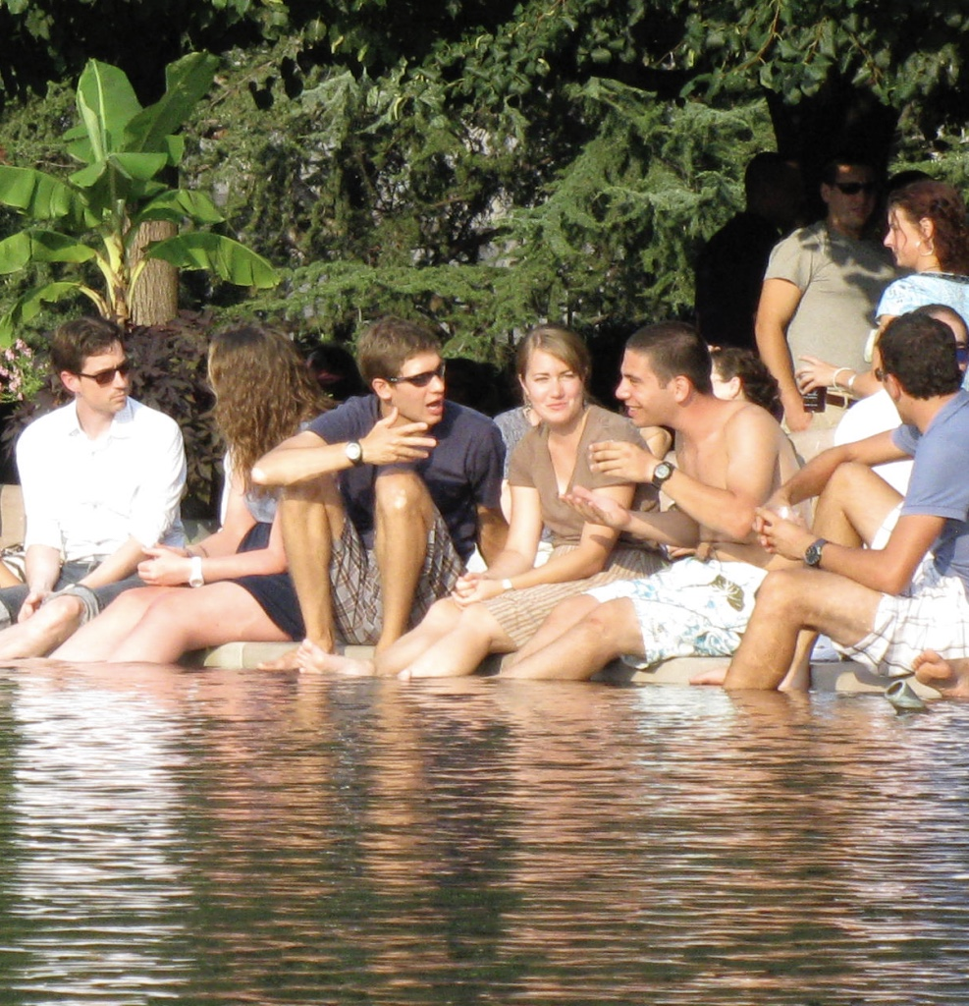
Listen: Practice Active Listening
Courtesy: L. de Silva
What is Conflict…?
Skills and Tools…
Research…

Slide 6
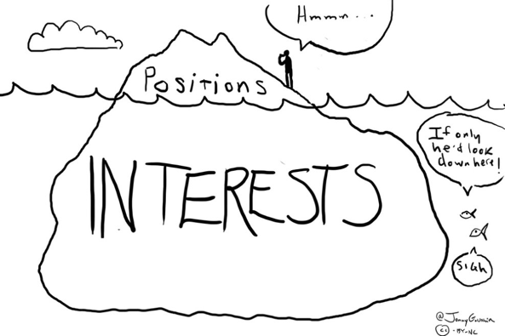
Know the “what” and “why”: Positions verses Interests
Image from https://clientmanagementvn.files.wordpress.com/2012/09/negotiations.jpg
What is Conflict…?
Skills and Tools…
Research…

Slide 7
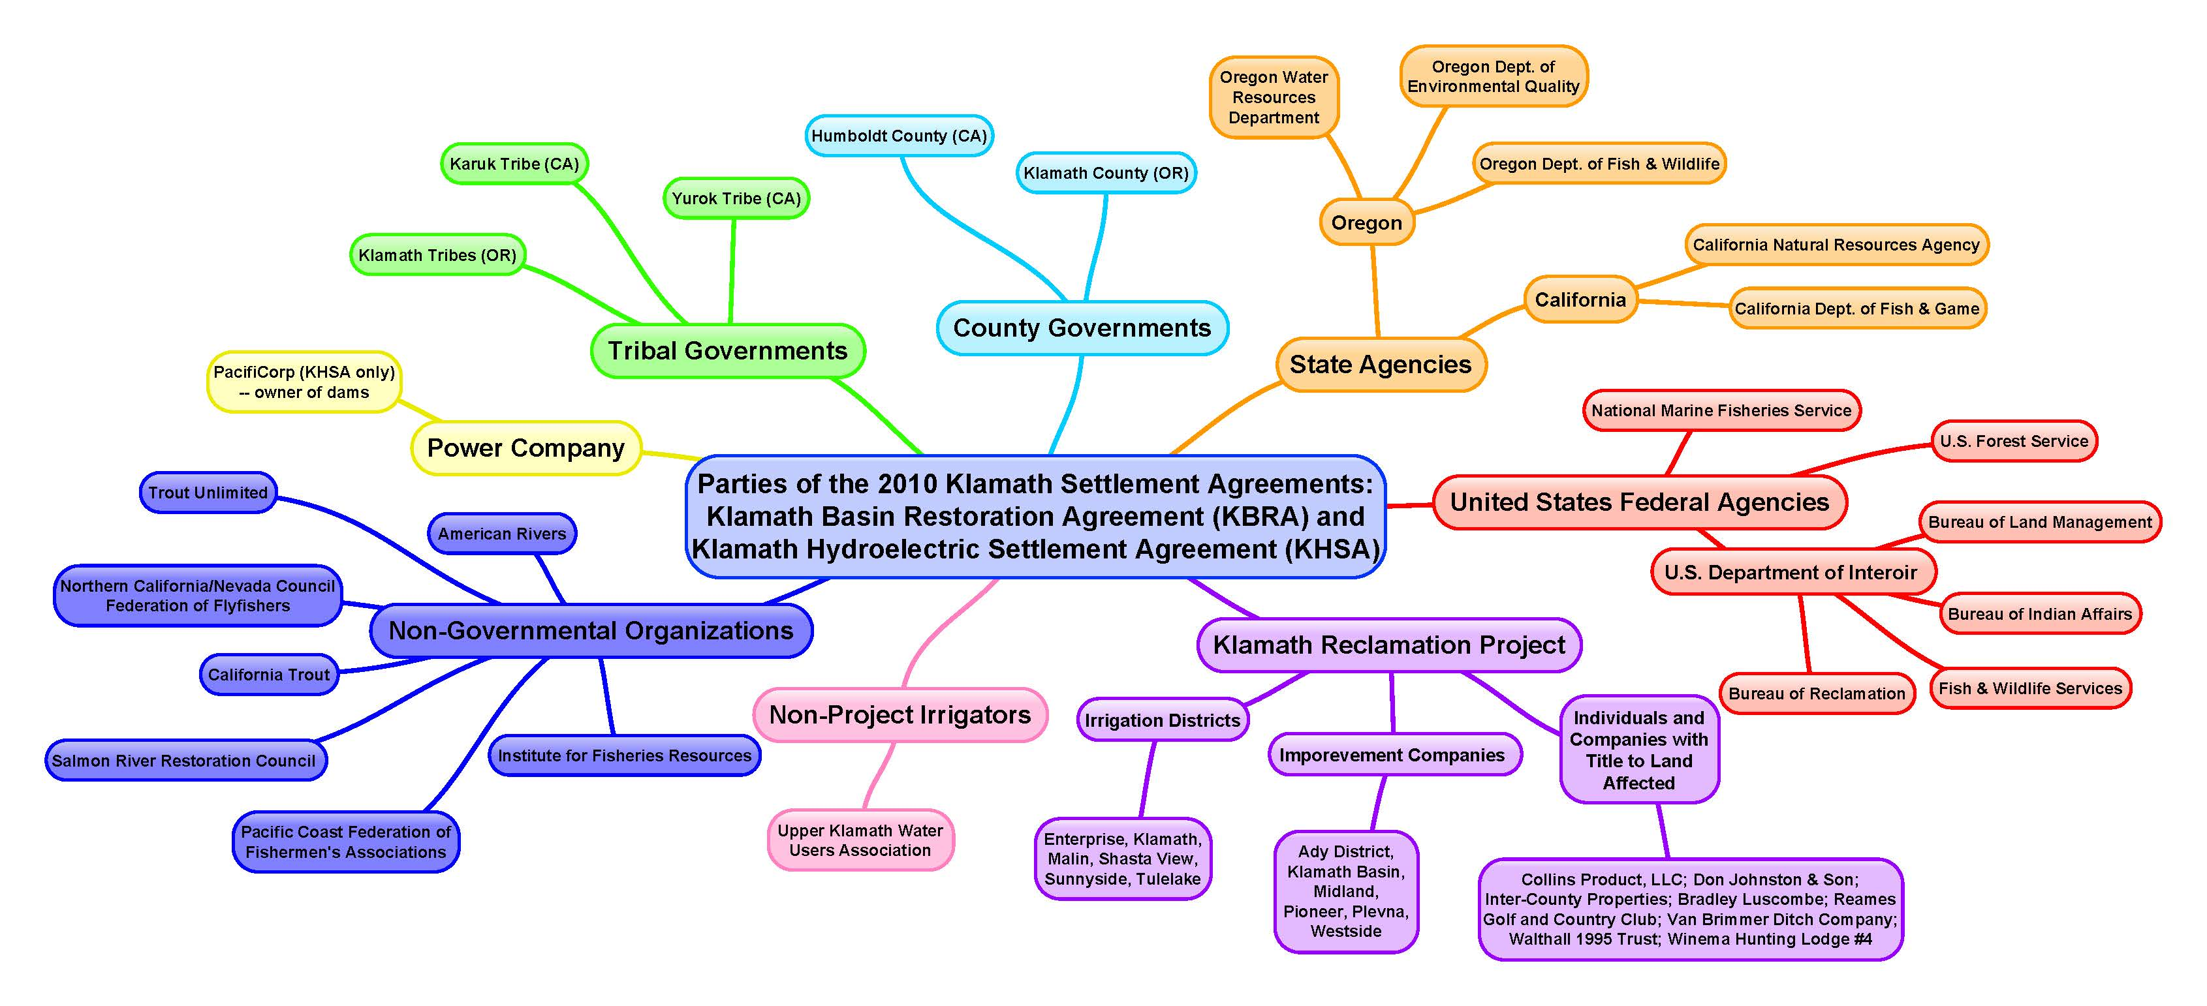
Use Situation Maps: Strengthen Communication
By Mariah Acton, 2014
What is Conflict…?
Skills and Tools…
Research…

Slide 8
Reframe: The Art of Dilemma-Posing
https://lisa-christiansen.com/2012/05/10/nlp-reframing-the-past-does-not-equal-the-future/
Formula
How can we address “A” and at the same time build “B”?
What is Conflict…?
Skills and Tools…
Research…

Slide 9
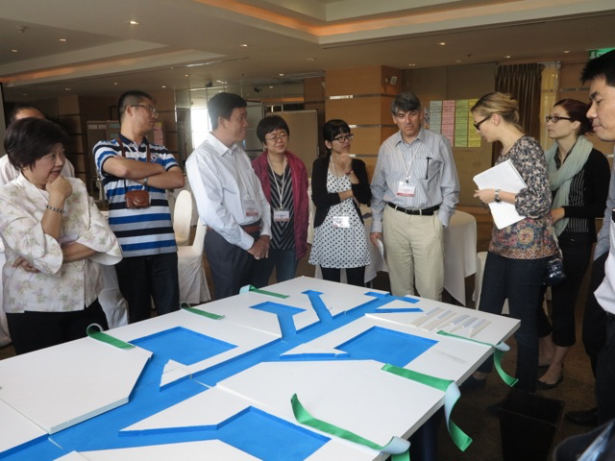
Experiential Learning: Explore Serious Gaming in Water
Courtesy: A. T. Wolf
Learn more at:
http://rainbowwatercoalition.blogspot.com/2016/04/serious-gaming-in-water.html
What is Conflict…?
Skills and Tools…
Research…

Slide 10
Explore Four Worlds: Water
Adversarial | Rights | Nations | Positions | Physical
Reflexive | Needs | Watersheds | Interests | Emotional
Integrative | Benefits | “Benefits - sheds” | Values | Knowing
Action | Equity | Region | Unity | Spiritual
Modified from Delli Priscoli & Wolf, 2009
What is Conflict…?
Skills and Tools…
Research…

Slide 11
Beyond the River: Benefits of Cooperation
Sadoff and Grey’s (2002)
The Challenges
The Opportunities
Type 1:
Increasing Benefits
To the river
Limited water resour. management: degraded watersheds, wetlands, biodiversity, & water quality.
Improved water quality, riverflow characteristics, soil conservation, biodiversity
Type 2:
Increasing Benefits
From the river
Sub-optimal water resources development
Improved hydropower & agricultural production, flood-drought management, environmental conservation & water quality
Type 3:
Reducing Costs
Because of the river
Policy shift to cooperation & development, from dispute; from food & energy self-sufficiency to security; reduced conflict risk & military expenditure
Tense regional relations & political economy impacts
Type 4:
Increasing Benefits
Beyond the the river
Regional fragmentation
Integration of regional infrastructure, markets & trade
What is Conflict…?
Skills and Tools…
Research…
Notes:
wATER MANAGEMENT IS BY DEFINAITION CONFLCICT MANAGMENT
Sub-optimal water resources development – INCREMENTAL PROJECTS THAT DO NOT ADDRESS THE ECOSYSTEM/COMMUNITY AT LARGE

Slide 12
Utilize Universities: Universities Consortium on Columbia River Governance
To Learn More Visit:
http://www.columbiarivergovernance.org/
What is Conflict…?
Skills and Tools…
Research…

Slide 13
Utilize Universities: Training
OSUs Program in Water Conflict Management and Transformation - http://www.transboundarywaters.orst.edu/
Tufts Water Diplomacy Program - http://ase.tufts.edu/igert/waterdiplomacy/
From Potential Conflict to Cooperation Potential - http://typo38.unesco.org/en/themes/water-education-and-training.html
UNESCO-Institute of Water Education - http://www.unesco-ihe.org/
What is Conflict…?
Skills and Tools…
Research…

Slide 14
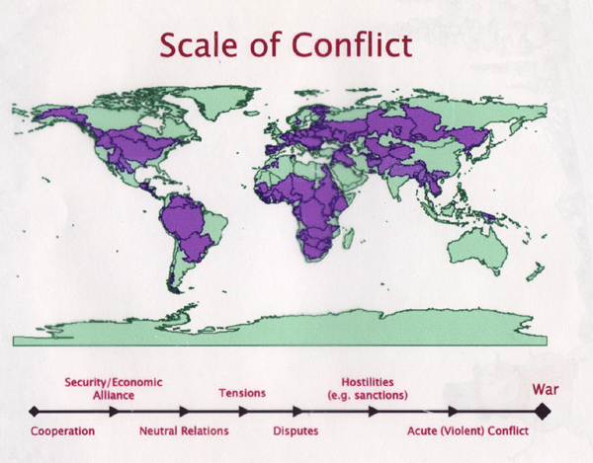
OSU: Basins at Risk
What is Conflict…?
Skills and Tools…
Research…

Slide 15
Events Database: Example
DATE
BASIN
COUNTRIES
BAR SCALE
EVENT SUMMARY
ISSUE TYPE
12/5/73
La Plata
Argentina--Paraguay
4
PRY AND ARG AGREE TO BUILD 1B DAM, HYDROELECTRIC PROJECT
Infrastructure
1/1/76
Ganges
Bangladesh--India--United Nations
-2
Bangladesh lodges a formal protest against India with the United Nations, which adopts a consensus statement encouraging the parties to meet urgently, at the level of minister, to arrive at a settlement.
Quantity
7/3/78
Amazon
Bolivia--Brazil--Colombia--Ecuador--Guyana--Peru--Suriname--Venezuela
6
Treaty for Amazonian Cooperation
Economic Development
4/7/95
Jordan
Israel--Jordan
4
Pipeline from Israel storage at Beit Zera to Abdullah Canal (East Ghor Canal) begins delivering water stipulated in Treaty (20 MCM summer, 10 MCM winter). The 10 mcm replaces the 10 mcm of desalinated water stipulated Annex II, Article 2d until desalinization plant completed
Quantity
6/1/99
Senegal
Mali--Mauritania
-3
13 people died in communal clashes in 6/99 along border between Maur. & Mali; conflict started when herdsmen in Missira-Samoura village in w. Mali, refused to allow Maur. horseman to use watering hole; horseman returned w/ some of his clansmen, attacking village on 6/20/99, causing 2 deaths; in retaliation that followed, 11 more died.
Quantity
What is Conflict…?
Skills and Tools…
Research…

Slide 16
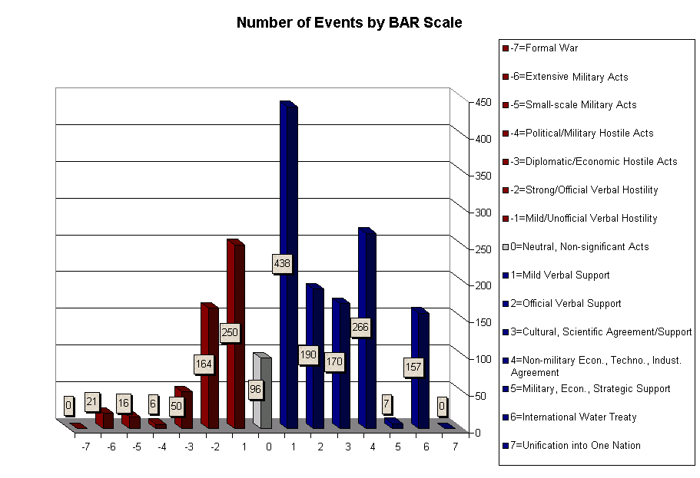
What is Conflict…?
Skills and Tools…
Research…

Slide 17
Basins at Risk: Working Hypothesis
“The likelihood of conflict rises as the rate of change within the basin exceeds the institutional capacity to absorb that change.”
- Aaron T. Wolf
What is Conflict…?
Skills and Tools…
Research…

Slide 18
Take Away: Water Conflict Management
Competing Interests Conflicts & Disputes
(Not necessarily too little water)
Made worse by:
Misperceptions
Entrenched thinking
Miscommunication
Managed by:
Focusing on interests and values, not positions (rights to needs to benefits to equity)
Focus on process and relationships, not dividing water
Institutions matter
Most Important Skill:
LISTEN!
What is Conflict…?
Skills and Tools…
Research…

Slide 19
Thank you!
Lynette de Silva
Contact me at: desilval@Oregonstate.edu
Visit us at: www.transboundarywaters.orst.edu/

