Slide 1
Storage Solutions
October 3, 2017
Presented by
J. Ryan Brownlee, PE
Associate Water Resources Engineer

Slide 2
Storage: Basic Concept
Step 1: Find River
Step 2: Build Dam
…….Right?
NOT SO FAST!

Slide 3
Overview
Surface Water Storage
Micro-Storage
less than 10 acre-feet
Small-Mid
up to 10,000 acre-feet
Large
over 10,000 acre-feet
Aquifer Storage and Recovery

Slide 4
Micro Storage (10 Acre-Feet)
Why?
Peaking: Ag. Frost Protection / Cooling
10 Acre-Feet = (~ 200 Acres of Orchard)
Below Permitting Thresholds:
Dam Safety RCW 90.03.350
Reservoir RCW 90.03.370
Economically Attractive

Slide 5
Micro Storage (10 Acre-Feet)

Slide 6
Small Storage (10 Acre-Feet)

Slide 7
Small-Mid (Up to 10,000 Acre-Feet)
Why?
Watershed Supply / Demand Imbalance
Examples:
Spring Creek Reservoir (Planning / New)
1,600 Acre-Feet, New Off-Channel
WRIA 30 – Klickitat
Appraisal Complete, Seeking Funding
Alpine Lakes Storage Optimization (Planning / Re-Operation)
6,400 Acre-Feet, Benefit from Existing Storage
WRIA 45 – Wenatchee
Draft PEIS Pending

Slide 8
Spring Creek Reservoir – WRIA 30
New Reservoir
Reliable Source Supply (Spring Fed)
Gravity Hydraulics
Instream and Out of Stream Benefit
1,600 acre-feet storage capacity
$3.5 Million / $2,200 per acre-foot
Next: Detailed Feasibility Study

Slide 9
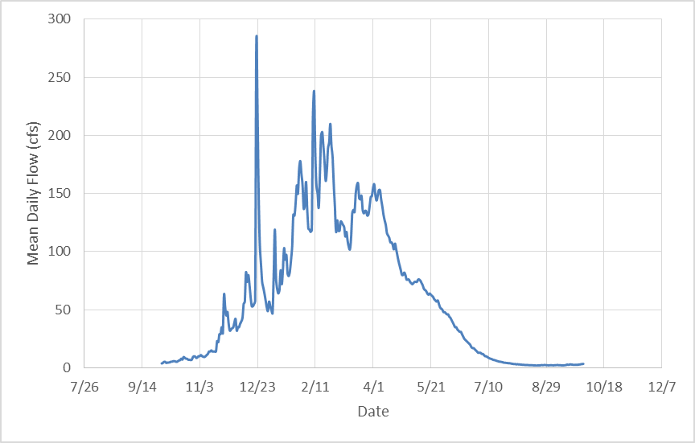
Spring Creek Reservoir – WRIA 30
Little Klickitat Streamflow
Temperature
And Flow
Issues
Little Klickitat River, Mean Daily Flows

Slide 10
Spring Creek Reservoir – WRIA 30
Existing
Proposed

Slide 11
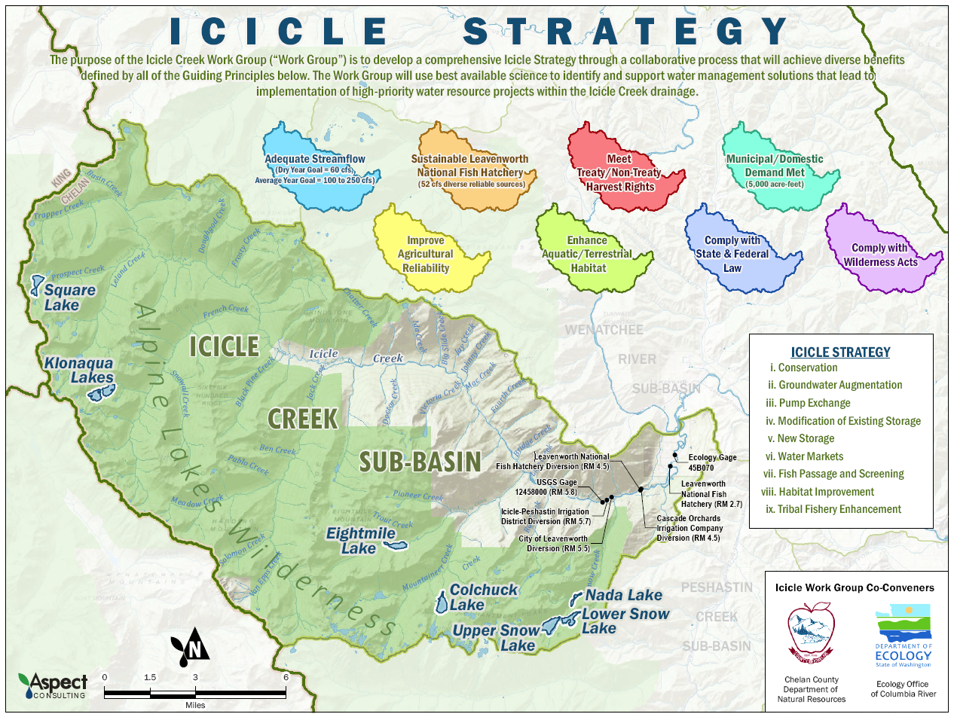
Alpine Lakes – WRIA 45

Slide 12
Alpine Lakes – WRIA 45
Modeled After Yakima Tea-Cup:

Slide 13
Alpine Lakes – WRIA 45

Slide 14
Alpine Lakes – WRIA 45

Slide 15
Large (Over 10,000 Acre-Feet)
New Reservoir
Case Study Examples:
Switzler Canyon Reservoir (Planning / New)
44,000 acre-feet, New Columbia River Off-Channel
WRIA 31 – Rock/Glade
EIS Pending
Existing Reservoir Reoperation Examples
Sullivan Lake Water Supply Project
Lake Roosevelt Incremental Storage Release

Slide 16
Switzler Canyon – WRIA 31

Slide 17
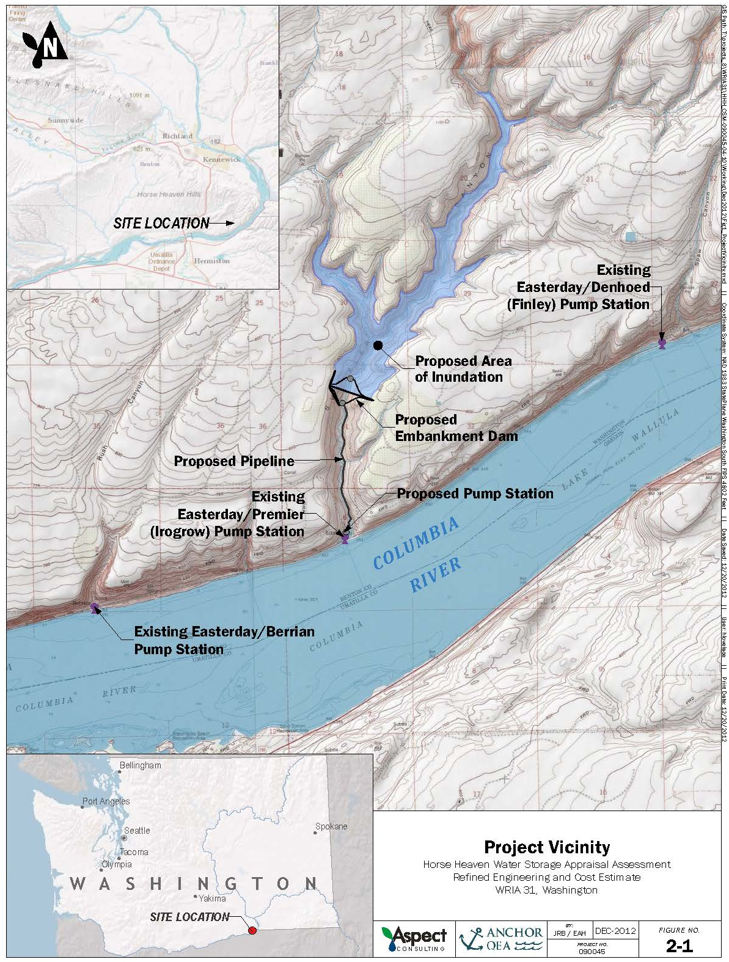
Switzler Canyon – WRIA 31

Slide 18
Existing Reservoir Reoperation
Sullivan Lake Water Supply Project
Conversion of Pend Oreille County PUD Hydropower Right to Water Supply
14,000 acre-feet (1/3 Instream)
Lake Roosevelt Drawdown
1-Foot Operational Change of Lake Roosevelt
25,000 ac-ft for Municipal (82,500 ac-ft total).

Slide 19
Aquifer Storage and Recovery (ASR)
City of White Salmon
Buck Creek Historical Source.
Groundwater After 2002.
Chronic Problems with Decreasing Well Yields
City Responds:
Reactivate Buck Creek
Construct ASR Project

Slide 20
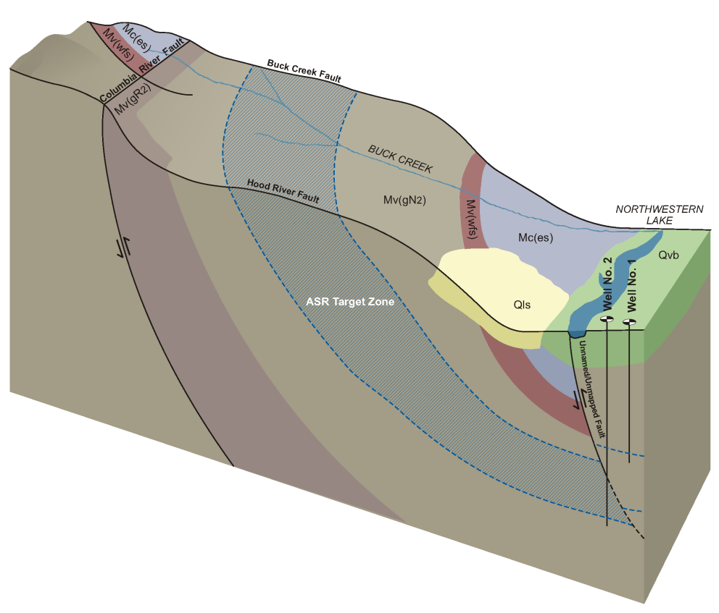
Aquifer Storage and Recovery (ASR)
Conceptual Model

Slide 21
ASR Regualtion
Washington State
173-157 WAC – Underground ASR
Water Right
Reservoir Permit
UIC Registration
Groundwater Antidegredation Policy
Both OCPI and AKART

Slide 22
White Salmon ASR Current Status
Pilot Test Successful
Now: Processing Water Right and Reservoir Permits
Soon: Full Scale Implementation Planned for 2018
Estimated Volume: 150 to 200 acre-feet.

Slide 23
Questions?
J. Ryan Brownlee, PE
Associate Water Resources Engineer

